Slide 1
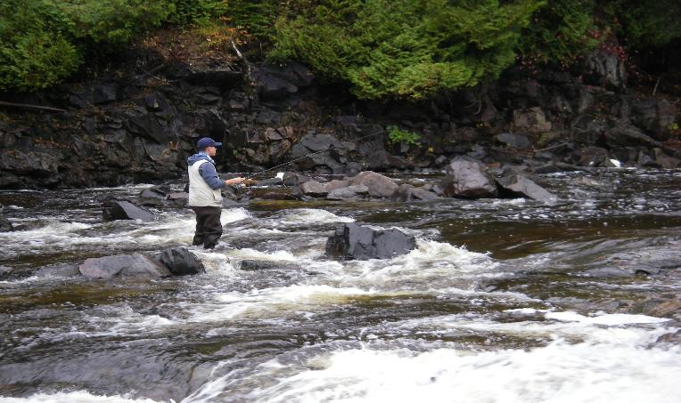


North Shore Steelhead Assessment A Partnership in Research
2026
By: Jon George and
Kyle Stratton

Slide 2
Introduction
Seven steelhead assessment projects were conducted during the spring of 2026.
A) Neebing River Steelhead Population Assessment
B) McIntyre River Steelhead Population Assessment
C) McVicar Creek Steelhead Population Assessment
D) MacKenzie River Steelhead Population Assessment
E) Portage Creek Steelhead Population Assessment
F) Cypress River Steelhead Population Assessment
G) Co-op Angler Study

Slide 3
Steelhead Assessment 2026
Projects and Methods
A) Neebing River
Population estimate, life history and tagging
B) McIntyre River
Population estimate and life history
C) McVicar Creek
Population estimate, life history and tagging
D) Mackenzie River
Population estimate, life history and tagging
E) Portage Creek
Population estimate, life history and tagging
F) Cypress River
Population estimate, life history and tagging
G) Co-op Angler
Anglers from the North Shore Steelhead Association received a sampling kit (measuring tape, glove, knife, envelopes and instructions) and biologically sampled their adult steelhead catches (fork length, sex, and scale samples) from north shore tributaries (Thunder Bay to Terrace Bay) from April to June. Scientific collectors permits were issued by MNR.
The population estimates were based on a ‘Petersen Population Estimate’; Adult
steelhead are fin clipped in year one and recaptured in year two. The repeat spawners with
fin clips in year two complete the formula.

Slide 4
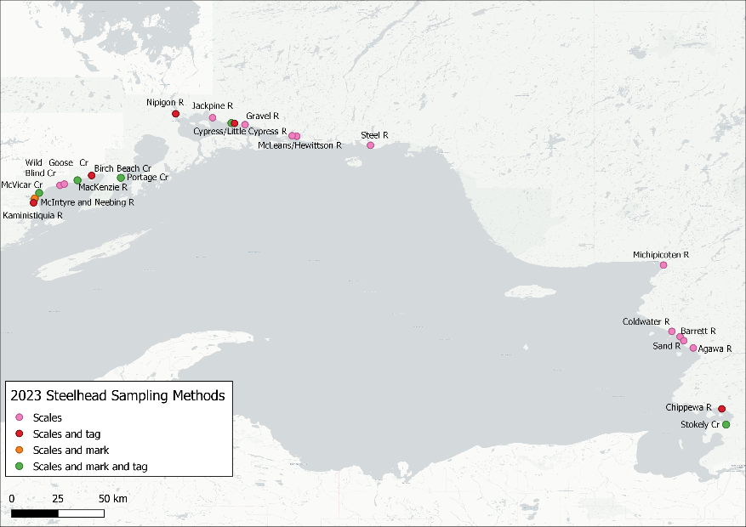
Steelhead Co-op Angler: Sampled Tributaries

Slide 5
Co-op Angler, Sample Size / Stream 2026
 |  | Basin | Tributary | Sample Size
A |  | Thunder Bay | Whitefish River | 21
 |  |  | Neebing River | 133
 |  |  | McIntyre River | 202
 |  |  | McVicar Creek | 100
 |  |  | Lake Shore Creeks | 29
 |  |  | MacKenzie River | 24
B |  | Black Bay | Portage Creek | 14
C |  | Nipigon Bay | Jackpine River | 29
 |  |  | Cypress River | 68
 |  |  | Steel River | 40
 |  |  | Nipigon east | 11

Slide 6
Petersen Population Estimate
Number of Fish Clipped in Year #1 X Repeat Spawners in Year # 2 / by Clips from Year # 1 Captured in Year # 2
Example :
185 Marked in Year #1
135 Repeat Spawners Year # 2
9 Marked fish from Year # 1 Captured in Year #2
185 X 135 = 2775 +-1707 @ 95 % Confidence
9
Estimated Number of Adults
Neebing River…..1536 (north branch 2025)
McIntyre River…..2775 +- 1707 (2025)
McVicar Creek…..1596 +- 1513 (2023)
Portage Creek….. 86 +- 57 (2024)
MacKenzie River.. 229 +- 21 (2025)
Cypress River……375 +- 20 (2025)
2025 population estimates for are based on recaptures from 2026

Slide 11
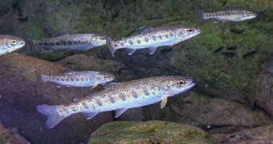
Smolting History
Steelhead reside in their home spawning stream for one to three years before migrating (smolting) to Lake Superior. At age one year the young steelhead are approximately 8 cm. in length, 16 cm at age two years and 24 cm. at age three years

Slide 12
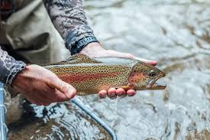
Age at First Spawn (Maturity)
At maturity males spend one to three years in Lake Superior and range in size from 30 to 60 cm. Females are generally a year older and spend two to four years in the lake environment and range from 48 to 65 cm.
Spawning steelhead have a strong homing instinct to the stream in which they were born.

Slide 13
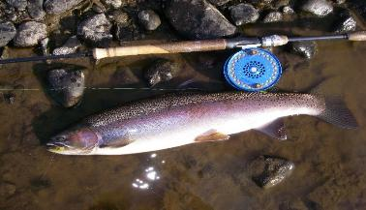
Repeat Spawners
Steelhead can repeat spawn in multiple years, some in as many as nine consecutive spawning migrations. Natural mortality each year is around 30%.
A healthy adult Steelhead population:
55% repeat spawners = 45% total annual mortality (30% natural mortality, 15% fishing mortality or harvest)

Slide 14
Weight and Age of your Steelhead
Figure A
Length to Weight
A 60 cm. (24”) steelhead may weigh 2.5 kg. or 5.5 Lbs.
A 75 cm. (30”) steelhead may weigh 3.8 kg or 8.5 Lbs.
Figure B
Fork Length to Age
A 50 cm. (20”) steelhead can be 3 years old
A 70 cm. (28”) steelhead can be 7 years old
Note: Length at age will vary depending
on stream life and maturity
Fig. A
Fig. B

Slide 15
What is happening in Black Bay ??
The adult estimated steelhead population size in Portage Creek in 1992 was 500….increasing to over 2000 by 2003. In 2024 the population was estimated at less than 100 individuals. (Fig. A).
In the early 1990 Portage Creek was open to fishing. In 1994 the lower stream was closed to fishing (private property). The increase in the adult steelhead population size (1994 to 2003) was probably the result of decreased harvest, followed by several strong production years (1998, 2000, 2001 and 2004).
The 2004 year class (age 3 in 2007, Fig. B) was the last strong year and the strongest recruitment of juveniles to the adult population since the study began in 1991. From 2006 to 2025 the recruitment of age three steelhead has been low (Fig. B).The decline in the adult steelhead population (Fig. A) is related to poor survival of juvenile steelhead from the smolt stage (migration from Portage Creek to Black Bay) to first time spawners. This decline in the steelhead population corresponds with changes in the Black Bay fish community after 2004. In 2023, the adult population size was the lowest since the study began in the early 1990’s.
Fig. A
Fig. B

Slide 16
Lake Superior Steelhead: Summary
Thunder Bay – populations are good
Urban Thunder Bay tributaries (Neebing, McIntyre and McVicar) still have significant numbers of large, older repeat spawning adults
Small Lake Shore tributaries have small adult steelhead populations with high annual mortality
The MacKenzie River has an adult population size of 229 +- 21 and a repeat spawning rate of 67% indicating a relatively small, fragile but sustainable steelhead stock
Black Bay – populations are very bad
Steelhead populations in Black Bay tributaries have declined significantly from historic levels
Portage Creek can be used to “index” other Black Bay steelhead population. Its population size has declined to 86 +- 57 (2024) from over 2000 (2007)… equivalent to > 95% decrease
Poor survival of juvenile smolts to first time spawning (2007 to 2025) and low angler success in most major tributaries (i.e., Wolf, Black Sturgeon and Coldwater), have occurred over the past fifteen years
Changes in the Black Bay fish community (i.e., Percids) have likely contributed to the decline in wild steelhead populations observed in Black Bay
Nipigon Bay – populations are getting bad
In Nipigon Bay, the Cypress Rivers had 74% repeat spawning with 28% new recruiting age classes (maiden spawners)
The 2025 adult population size in the Cypress River was 375 +- 20, a 47% decline from 2024
The Cypress River acts as an Index stream for Nipigon steelhead abundance
The Steel River had rather a wide variety of life history strategies that includes a small group of resident adults

Slide 17
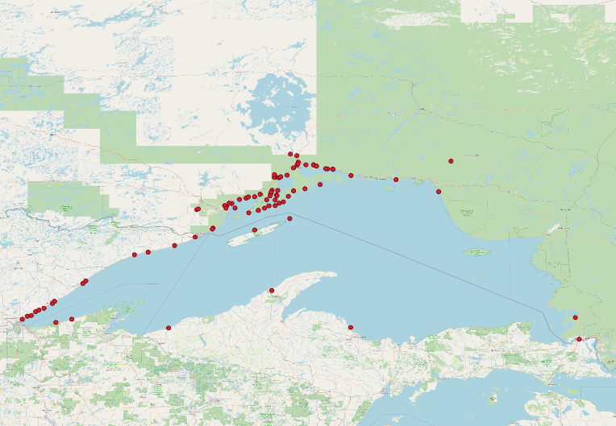
Steelhead tag returns from Ontario’s Western Lake Superior tributaries

Slide 18
Acknowledgements
We would like to thank the following persons and groups for their contribution to the co-op angle
program.
Neebing River Population Study:
Joe, Bailey, Jon George and Kyle Stratton
McIntyre River Population Study:
Randy Beamish and Keith Ailey
McVicar Creek Population Study:
Landan Brochu, Keith Ailey, and Kyle Stratton
Blind, Wild Goose and Birch Beach Creeks:
Derek Klement and Landan Brochu
Mackenzie River Population Study:
Kyle Stratton
Jackpine, Cypress and Nipigon Bay tributaries data collection:
Wes Bender, Keith Ailey, Dave Stoot, Scott Thorp, Maria Manion, and Kyle Stratton
Steel River:
Kyle Stratton
Aging and Data Management:
Jon George
Funding:
NSSA and the Upper Great Lakes Management Unit (MNR)
Budget control and web site:
Frank Edgson

Slide 19
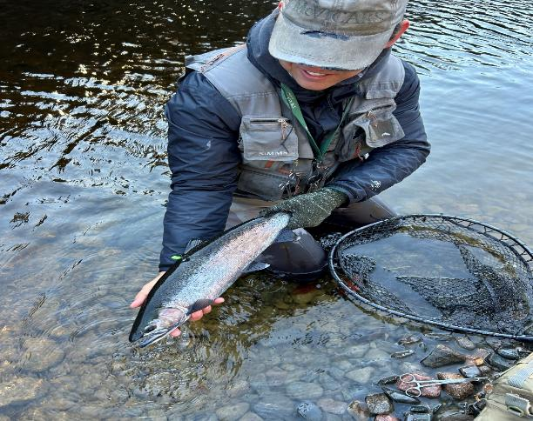
Wild Steelhead Populations are in Your Hands

