Slide 1
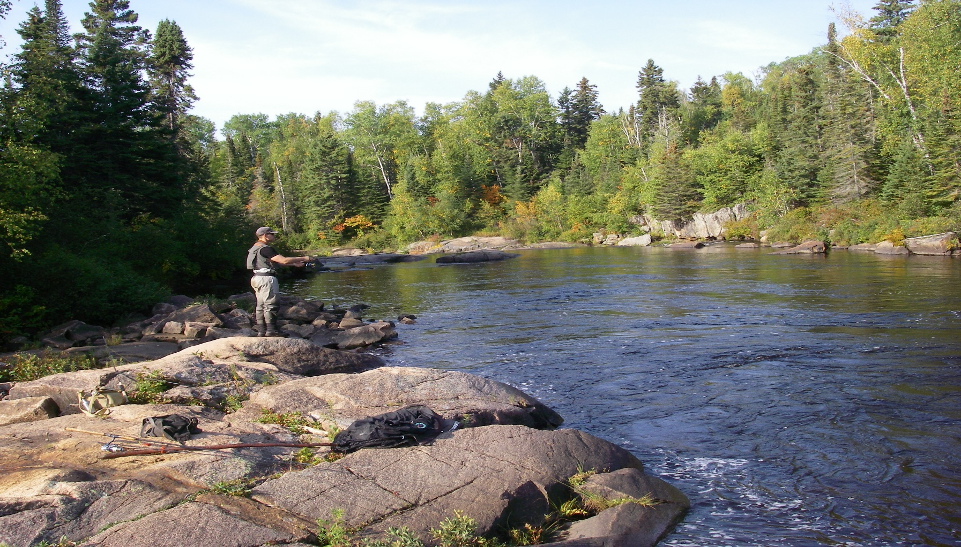


North Shore Steelhead Assessment A Partnership in Research
2022
By: Jon George,
Project Manager
Thunder Bay

Slide 2
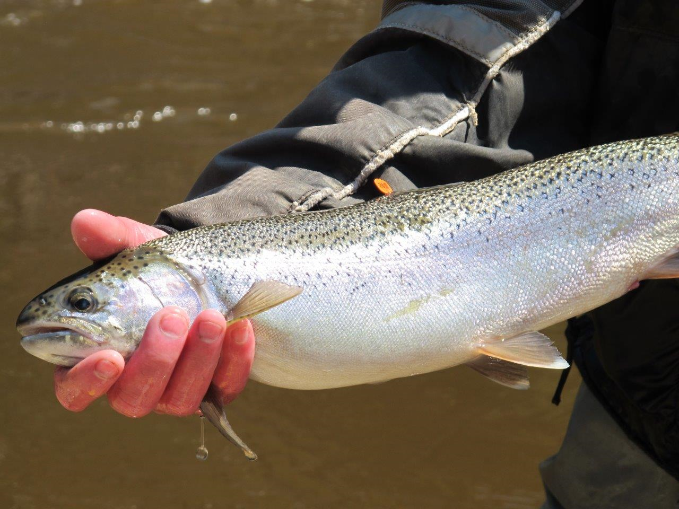
Wild Lake Superior Steelhead

Slide 3
Goals and Objectives
Partnership with Ontario Ministry of Natural Resources and
Forestry (OMNRF), Upper Great Lakes Management Unit
(UGLMU) and the North Shore Steelhead Association (NSSA)
Annually documenting the status of wild steelhead populations
in tributaries of western Lake Superior using adult population
estimates and life history characteristics
Applied science that can be used to develop steelhead
management plans and harvest regulations
Monitor present regulations and habitat manipulation…. before
and after (adaptive management)

Slide 4
Co-op Angler 2022
Introduction
Five steelhead assessment projects were conducted during the spring of 2022.
They were:
A) McIntyre River Steelhead Population Assessment
B) McVicar Creek Steelhead Population Assessment
C) MacKenzie River Steelhead Population Assessment
D) Cypress River Steelhead Population Assessment
F) Co-op Angler Study
All studies were conducted in partnership with the North Shore Steelhead Association (NSSA) and the Ontario Ministry of Natural Resources and Forestry, Upper Great Lakes Management Unit (OMNRF, UGLMU).

Slide 5
Steelhead Assessment 2022
Projects and Methods
A) McIntyre River Steelhead Population Assessment
Four experienced anglers biologically sampled, fin clipped adult steelhead they captured while angling during the
spring spawning migration (May and June).
B) McVicar Creek
One experienced angler/biologist biologically sampling and fin clipping adult steelhead
during the spawning migration (April to June).
C) Lake Shore Drive streams
Wild Goose, Blend and Birch Beach Creeks were extensively angled and sampled by Derek Klement and to a less extent
by Kyle Stratton
D) Mackenzie River
One experienced angler/biologist biologically sampling, fin clipping and tagged adult steelhead during the spawning
migration (April to June).
E) Cypress River
OMNR (Upper Great Lakes Management Unit), Kyle Stratton and Wes Bender initiated a population study by fin
clipping and tagging their angled catch.
E) Co-op Angler
Anglers from the North Shore Steelhead Association received a sampling kit (measuring tape, glove, knife, envelopes
and instructions) and biologically sampled their adult steelhead catches (fork length, sex, and scale samples)
from north shore tributaries (Thunder Bay to Terrace Bay) from April to June. Scientific collectors permits were issued
by OMNRF.
The population estimates were based on a ‘Petersen Population Estimate’; Adult
steelhead are fin clipped in year one and recaptured in year two. The repeat spawners with
fin clips in year two complete the formula.

Slide 6
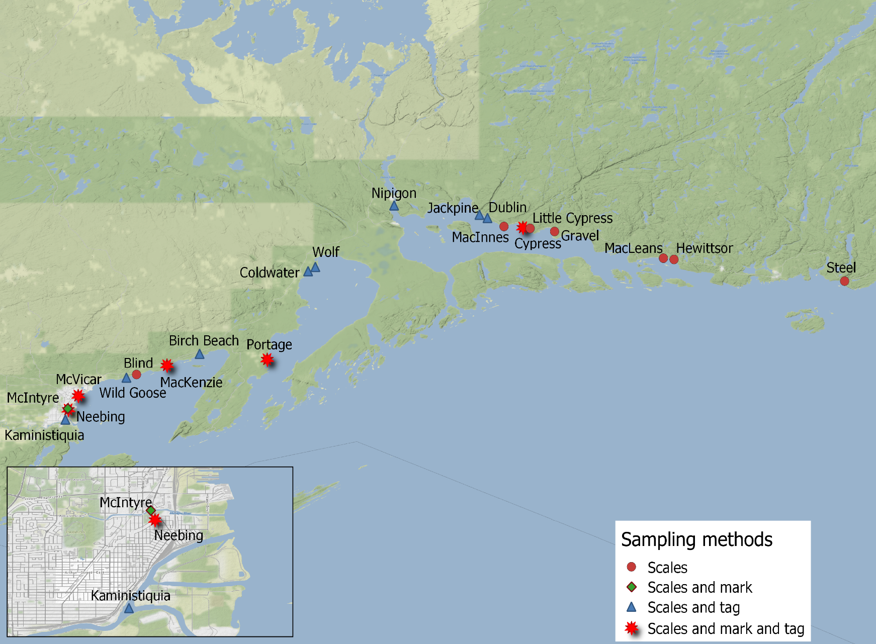
Steelhead Co-op Angler: Sampling Tributaries

Slide 7
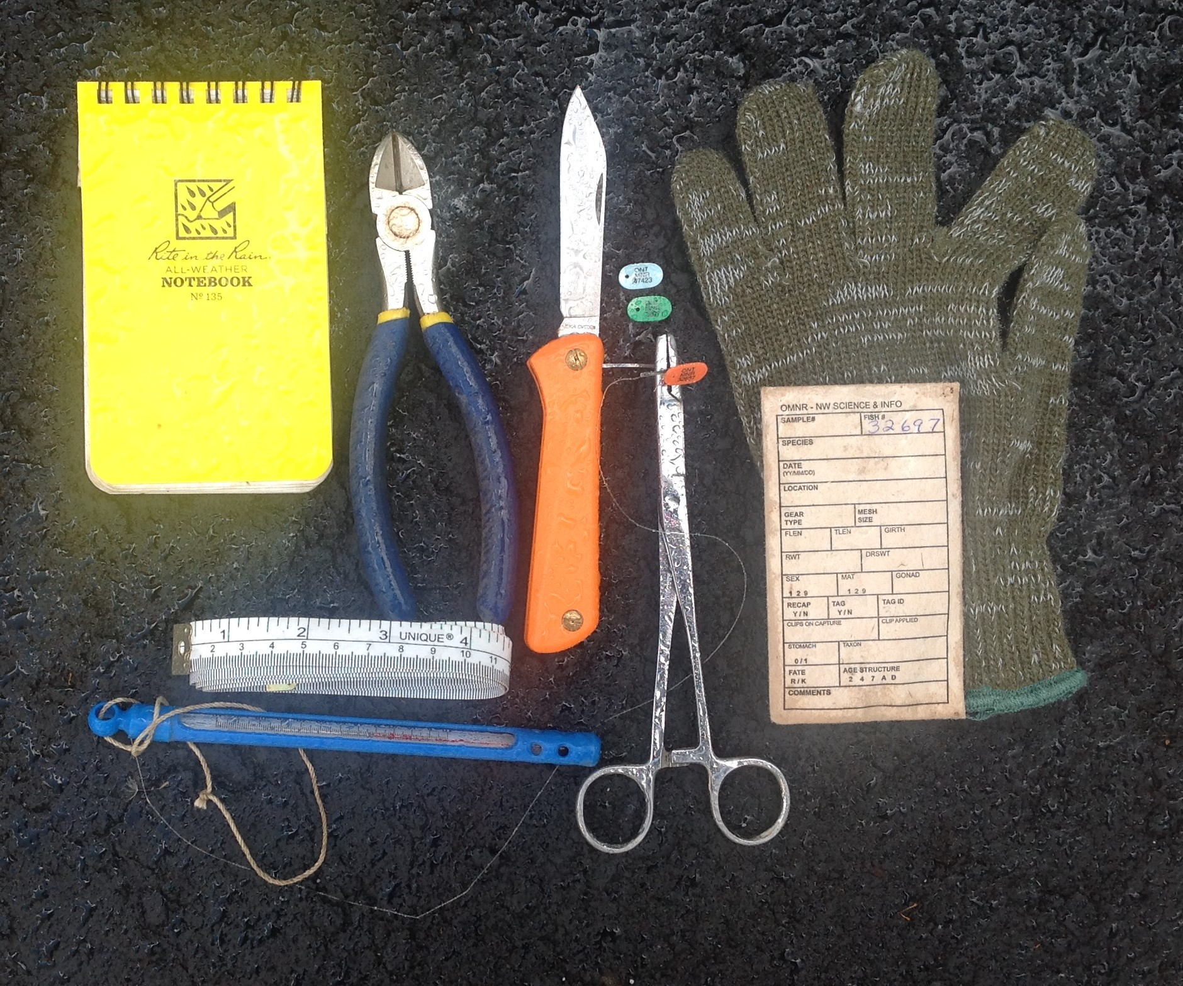
Sampling Kit

Slide 8
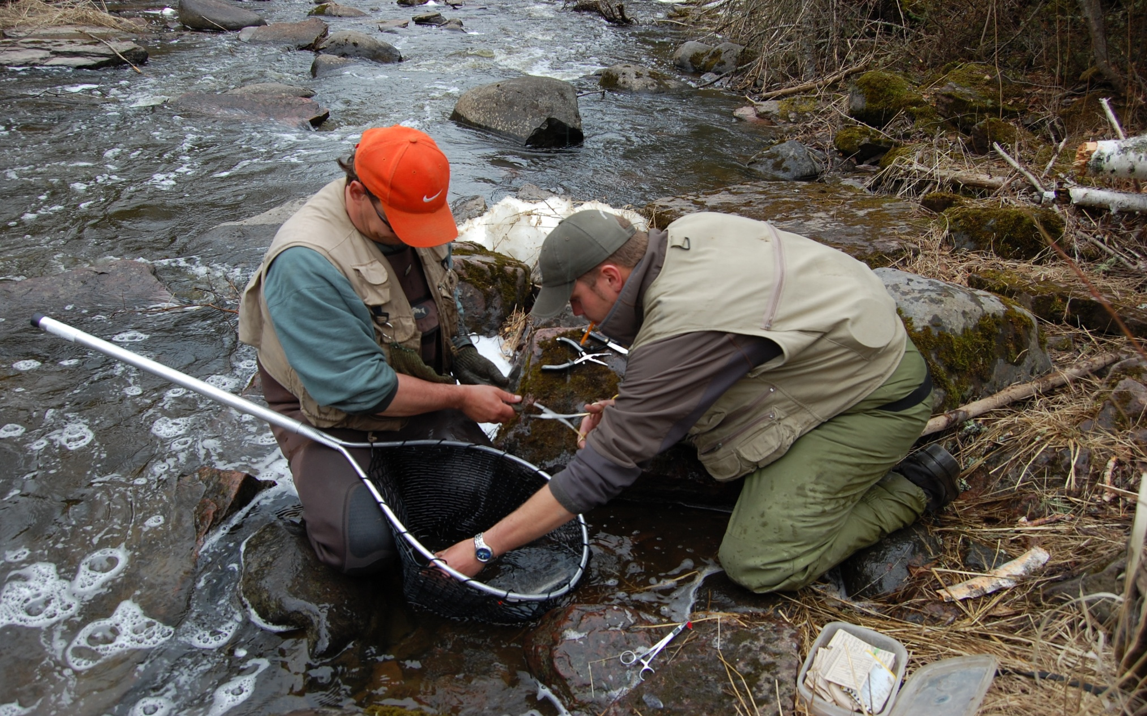
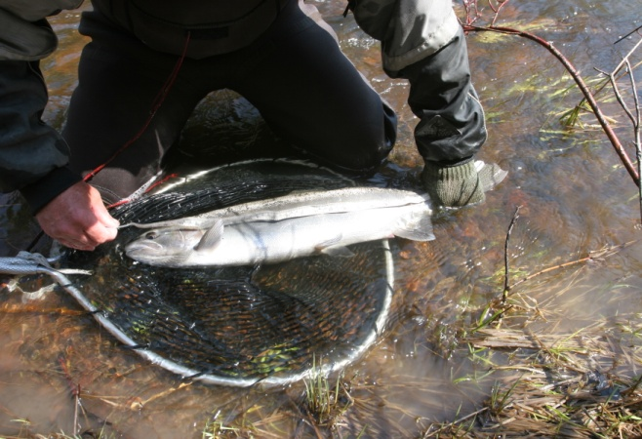
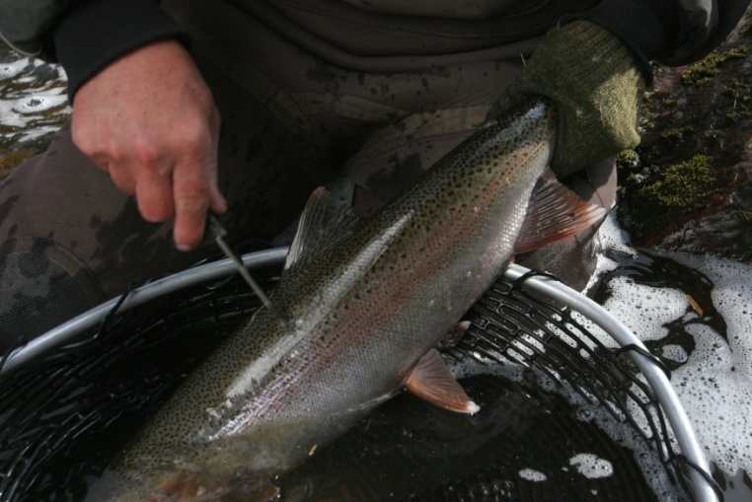
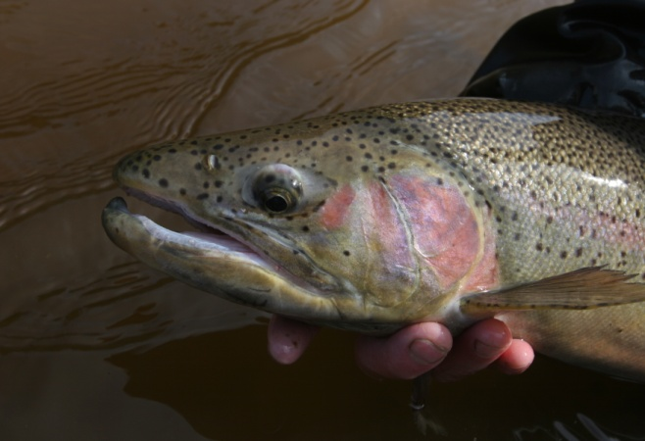
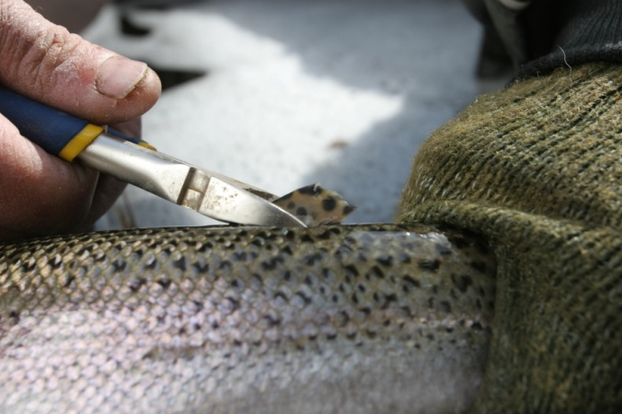
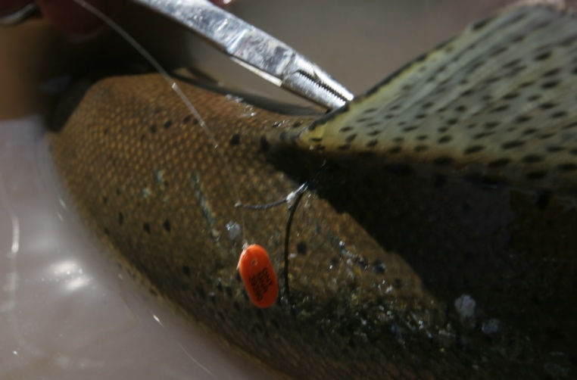
Sampling Procedure
Fork length (mm)
Sampling station
Scale sample
Male or Female
Yearly fin clip
Coloured, numbered tag

Slide 9
Co-op Angler, Sample Size / Stream 2022
 |  | Basin | Tributary | Sample Size
A |  | Thunder Bay | Whitefish River | 34
 |  |  | Neebing River | 30
 |  |  | McIntyre River | 277
 |  |  | McVicar Creek | 201
 |  |  | Lake Shore Creeks | 111
 |  |  | MacKenzie River | 74
B |  | Black Bay | Portage Creek | 3
 |  |  | Black Bay Trib. | 6
C |  | Nipigon Bay | Jackpine River | 46
 |  |  | Cypress River | 104
 |  |  | Gravel River | 13
 |  |  | Steel River | 25
 |  |  | Nipigon east Creeks | 25

Slide 10
Petersen Population Estimate
Number of Fish Clipped in Year #1 X Repeat Spawners in Year # 2 / by Clips from Year # 1 Captured in Year # 2
Example :
359 marked in Year #1
305 Repeat Spawners Year # 2
31 Marked fish from Year # 1 Captured in Year #2
359 X 305
------------ = 3532 +- 1126 @ 95 % Confidence (year #1)
31
Estimated Number of Adults
Neebing River…..2133 +- 1169 (north branch 2020)
McIntyre River…..5263 +- 2513 (2021)
McVicar Creek…..2184 (2020)
Portage Creek…..182 (2020)
MacKenzie River..328 +- 178 (2021)
2021 population estimates for are based on recaptures from 2022

Slide 13
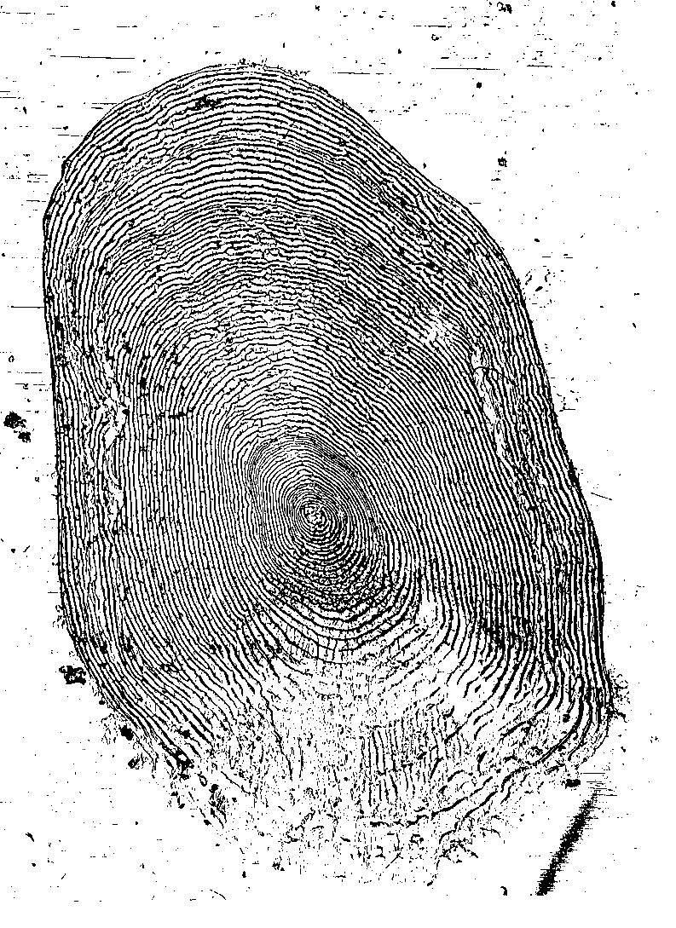
Data Obtained from Scale Samples
Number of stream years
Number of lake years
Total age
Age at maturity
Lake Years at Maturity
Number of spawning events
Size at age

Slide 14

Life History
Steelhead Scale: Age 5 years
(2 stream, 3 lake, 3rd spawn)
Third Lake Year, Third Spawn
Second Lake Year, Second Spawn
First Lake Year, First Spawn
Second Stream Year
First Stream Year
Notes:
EB: I moved this slide so that it is now an example for what you describe in slide 11

Slide 15
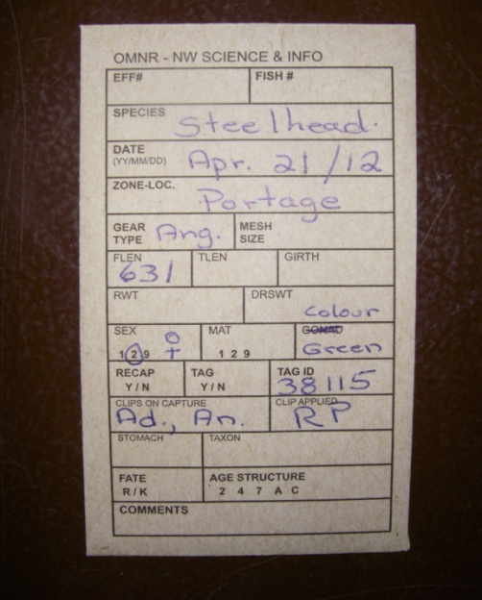
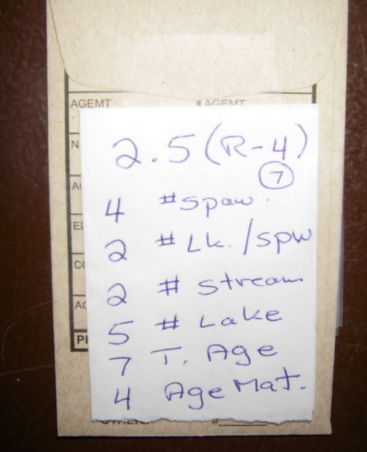
Data Management
A: Fish data is recorded on the
front of envelope, the scale
sample is placed inside.
B: Life history is coded on the back
of the envelope following scale
age / life history interpretation
C: Life history data is transferred to
Excel spread sheet
A
B
Portage Creek Spring
 |  |  |  |  |  |  |  |  |  |  |  |  |  |  | Clips on Capture
Year | Date(d/m/y) | Colour | Tag | Flen | Lamp. | Sex | Spw. | L/spw. | Str. | Lk. | Age | Mat. | CLA | CLC3(FD) | CLC1(AD) | CLC7(RP) | CLC2(AN) | CLC5(LV)
2012 | 15/04/2012 | Yellow | 49000 | 432 |  | 1 | 1 | 2 | 1 | 2 | 3 | 3 | RP
2012 | 15/04/2012 | Yellow | 49001 | 581 |  | 2 | 2 | 2 | 2 | 3 | 5 | 4 | RP
2012 | 15/04/2012 | Yellow | 49002 | 384 |  | 1 | 1 | 2 | 1 | 2 | 3 | 3 | RP
2012 | 15/04/2012 | Yellow | 49003 | 479 | S | 1 | 2 | 1 | 1 | 2 | 3 | 2 | RP
2012 | 15/04/2012 | Yellow | 48004 | 614 |  | 1 | 2 | 3 | 1 | 4 | 5 | 4 | RP
2012 | 15/04/2012 | Yellow | 49005 | 366 |  | 1 | 1 | 1 | 1 | 1 | 2 | 2 | RP
2012 | 15/04/2012 | Yellow | 49006 | 551 |  | 1 | 2 | 2 | 1 | 3 | 4 | 3 | RP |  |  |  | An
2012 | 15/04/2012 | Yellow | 49008 | 594 | W | 2 | 6 | 2 | 1 | 7 | 8 | 3 | RP
2012 | 15/04/2012 | White | 44050 | 522 |  | 1 | 3 | 1 | 1 | 3 | 4 | 2 | RP |  | Ad |  |  | LV
2012 | 21/04/2012 | Yellow | 49009 | 492 |  | 2 | 1 | 2 | 1 | 2 | 3 | 3 | RP
2012 | 21/04/2012 | Yellow | 49010 | 521 |  | 2 | 1 | 2 | 1 | 2 | 3 | 3 | RP
2012 | 21/04/2012 | Green | 38115 | 631 |  | 2 | 4 | 2 | 2 | 5 | 7 | 4 | RP |  | Ad |  | An
C
Notes:
EB: If your short on time, remove this slide or be brief.

Slide 18
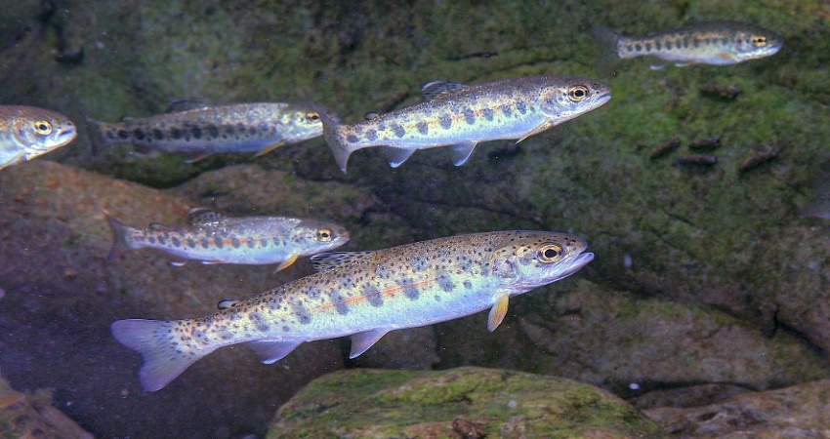
Smolting History 2022
Steelhead reside in their home spawning stream for one to three years before migrating (smolting) to Lake Superior. At age one year the young steelhead are approximately 8 cm. in length, 16 cm at age two years and 24 cm. at age three years

Slide 19
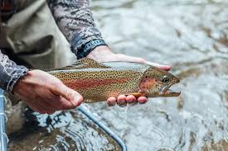
Age at First Spawn (Maturity)
At maturity males have spent one to three years in Lake Superior and range in size from 30 to 60 cm. Females are generally a year older and have spent two to four years in the lake environment and range from 48 to 65 cm.
Spawning steelhead have a strong homing instinct to the stream in which they were born.

Slide 20
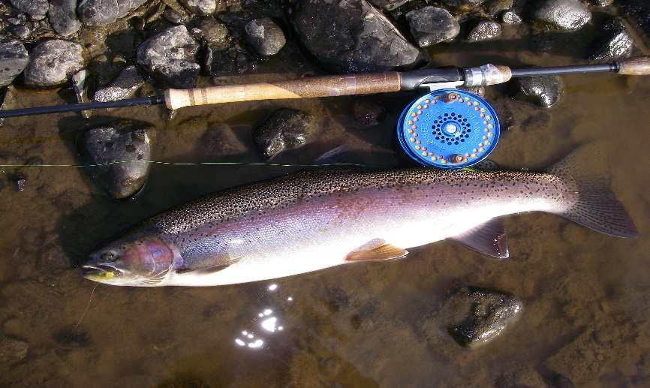
Repeat Spawners
Steelhead have the ability to repeat spawn in multiple years some in as many as nine consecutive spawning migrations. Natural mortality each spawning year can be high (~30%)
A healthy adult Steelhead population:
55% repeat spawners = 45% total annual mortality (30% natural mortality, 15% fishing mortality or harvest)

Slide 21
Weight and Age of your Steelhead
Figure A
Length to Weight
A 60 cm. (24”) steelhead may weigh 2.5 kg. or 5.5 Lbs.
A 75 cm. (30”) steelhead may weigh 3.8 kg or 8.5 Lbs.
Figure B
Fork Length to Age
A 50 cm. (20”) steelhead can be 3 years old
A 70 cm. (28”) steelhead can be 7 years old
Note: Length at age will vary depending
on stream life and maturity
Fig. A
Fig. B

Slide 22
What is happening in Black Bay ??
The adult estimated steelhead population size in Portage Creek in 1992 was 500….increasing to over 2000 by 2003. In 2020 the population was estimated at less than 200 individuals. (Fig. A).
In the early 1990 Portage Creek was open to fishing. In 1994 the lower stream was closed to fishing (private property). The increase in the adult steelhead population size (1994 to 2003) was probably the result of decreased harvest, followed by several strong production years (1998, 2000 and 2001).
The 2004 year class (age 3 in 2007) (Fig. B) was the last strong year and the strongest recruitment of juveniles to the adult population since the study began in 1991. From 2006 to 2019 the recruitment of age three steelhead has been low (Fig. B).The decline in the adult steelhead population (Fig. A) appears to be related to poor survival of juvenile steelhead from the smolt stage (migration from Portage Creek to Black Bay) to first time spawners. This decline in the steelhead population appears to correspond with changes in the Black Bay fish community after 2004.
Fig. A
Fig. B

Slide 23
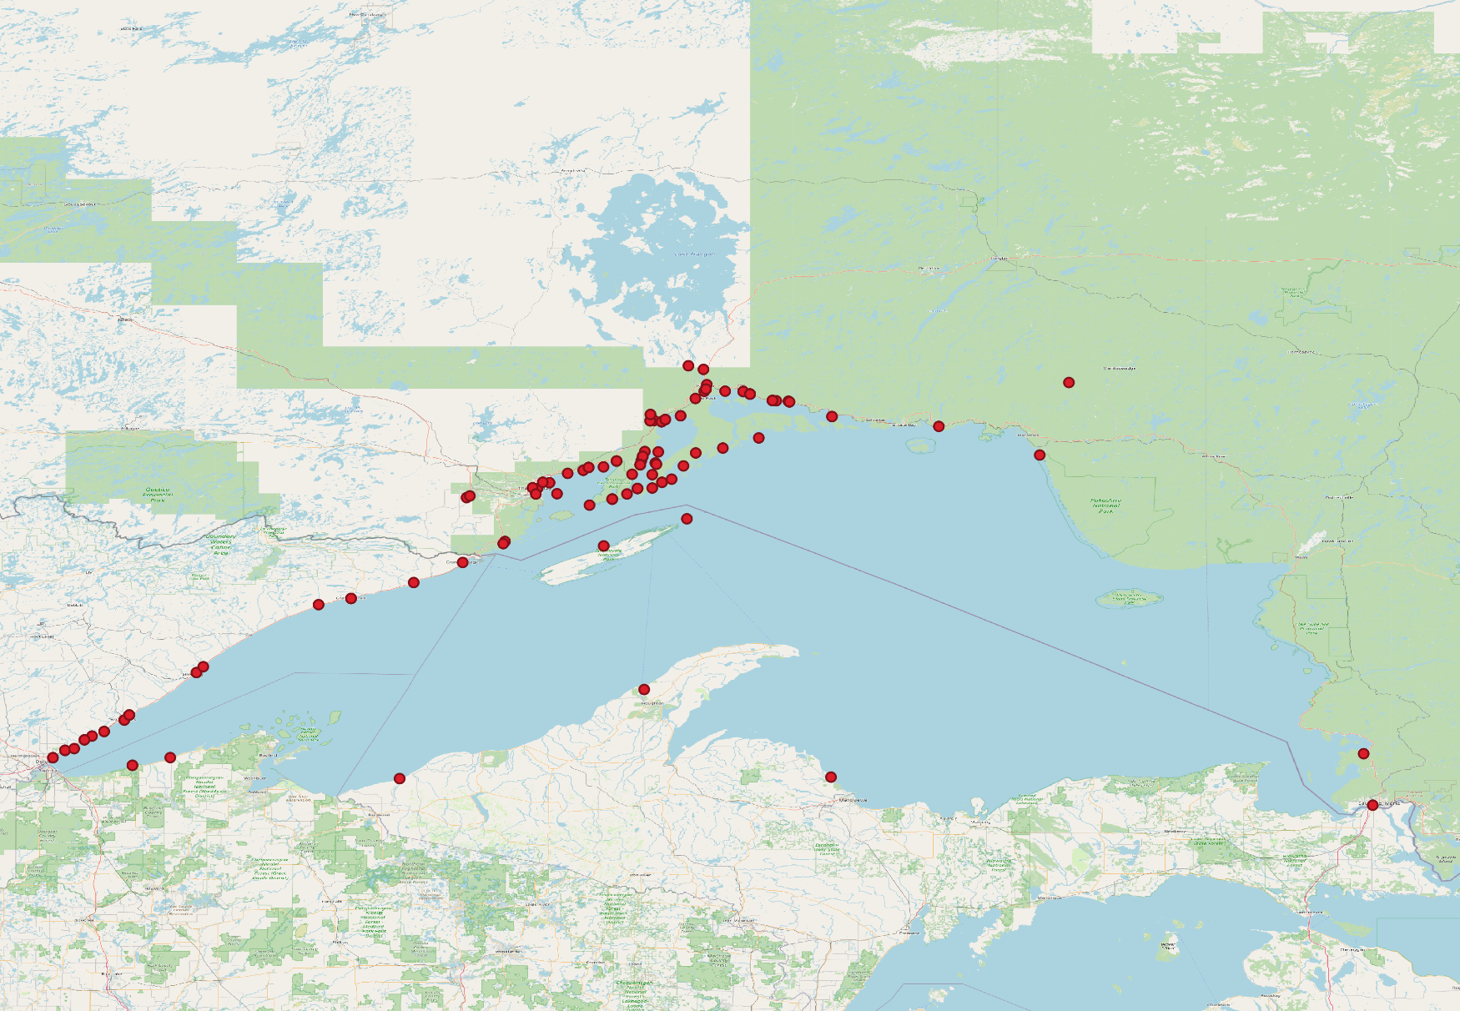
Steelhead tag returns from Ontario’s Western Lake Superior tributaries

Slide 24
Lake Superior Steelhead: Summary
Thunder Bay
The McIntyre River and McVicar Creek have large adult populations with low annual mortality
Small Lake Shore tributaries have relatively small adult steelhead populations with high annual mortality
The MacKenzie River has an adult population size of 328+- 178 (2021) and a repeat spawning rate of 59% indicating a relatively small, fragile but sustainable steelhead stock.
Black Bay
Steelhead populations in Black Bay tributaries have declined from historic levels.
Portage Creek can be used to “index” other Black Bay steelhead population. Its population size has declined to under 200 from over 2000 (2007)… equivalent to a 90% decrease.
Poor survival of juvenile smolts to first time spawning (1995 to 2019) and low angler success in most major tributaries ie. Wolf, Black Sturgeon and Coldwater, has occurred over the past ten years.
Changes in the Black Bay fish community may have contributed to the apparent widespread decline in wild steelhead populations.
Nipigon Bay
Two tributaries of Nipigon Bay (Jackpine, Cypress Rivers) had high repeat spawning levels > 75 % but low recruiting age classes.
A more quantitative study on the Cypress River initiated in 2022 should address questions regarding adult steelhead population size in Nipigon Bay tributaries.

Slide 25
Acknowledgements
The author of this report would like to thank the following persons and groups for their contribution to the co-op angler program.
McIntyre River Population Study:
Randy Beamish, Keith Ailey, Terry Kosolowski, Kyle Stratton
McVicars Creek Population Study:
Kyle Stratton
Blind, Birch Beach and Birch Beach Creeks:
Derek Klement, Kyle Stratton
Mackenzie River Population Study:
Kyle Stratton,
Jackpine, Cypress and Nipigon Bay tributaries data collection:
Wes B., Keith A., Kyle S., Mike S., Jason V., Dave S., Jon T., Scott M. and OMNRF
Aging and Data Management:
Jon Tost and Cyn Chappel, North Shore Environmental Services (NSES)
Corporate Sponsors:
Ray Collesso, Hook Line and Sinker, Guelph, Ontario
Funding:
NSSA and the Upper Great Lakes Management Unit (OMNRF)
Budget control and web site:
Frank Edgson and Scott McFadden

Slide 26
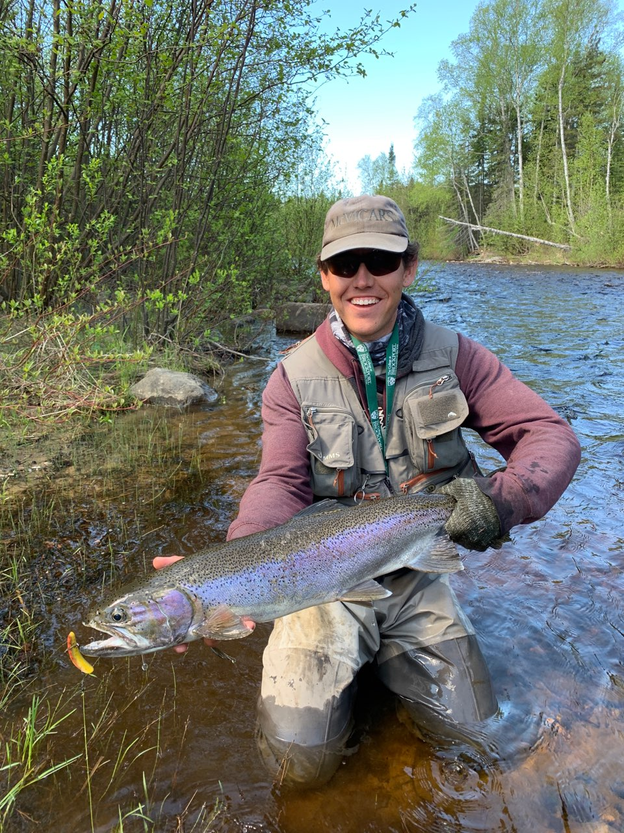
The Protection of Lake Superior’s Wild Steelhead Fishery is in Your Hands

