Slide 1
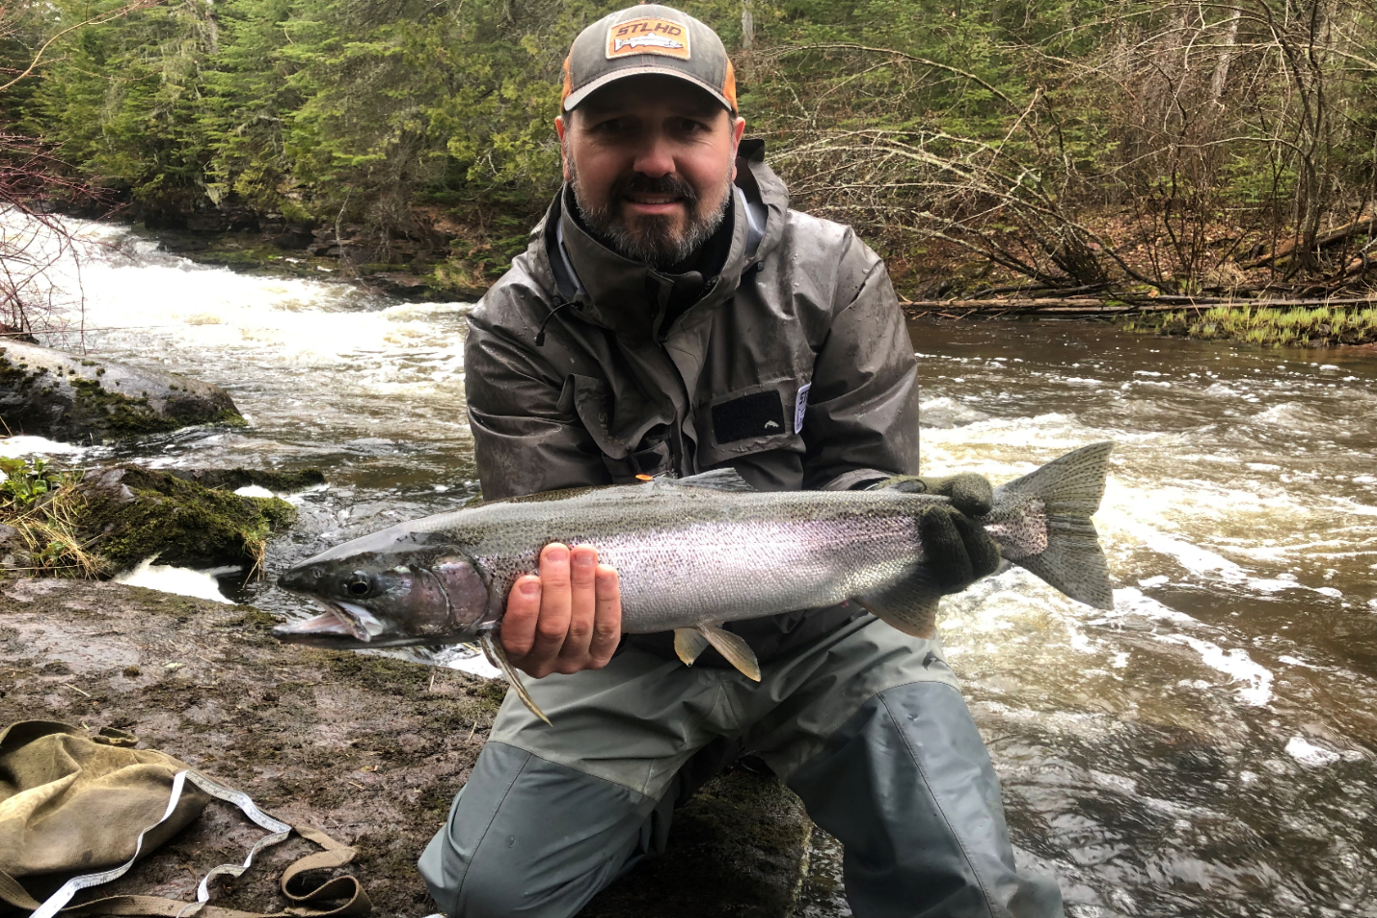


North Shore Steelhead Assessment A Partnership in Research
2019
By: Jon George
Thunder Bay

Slide 2
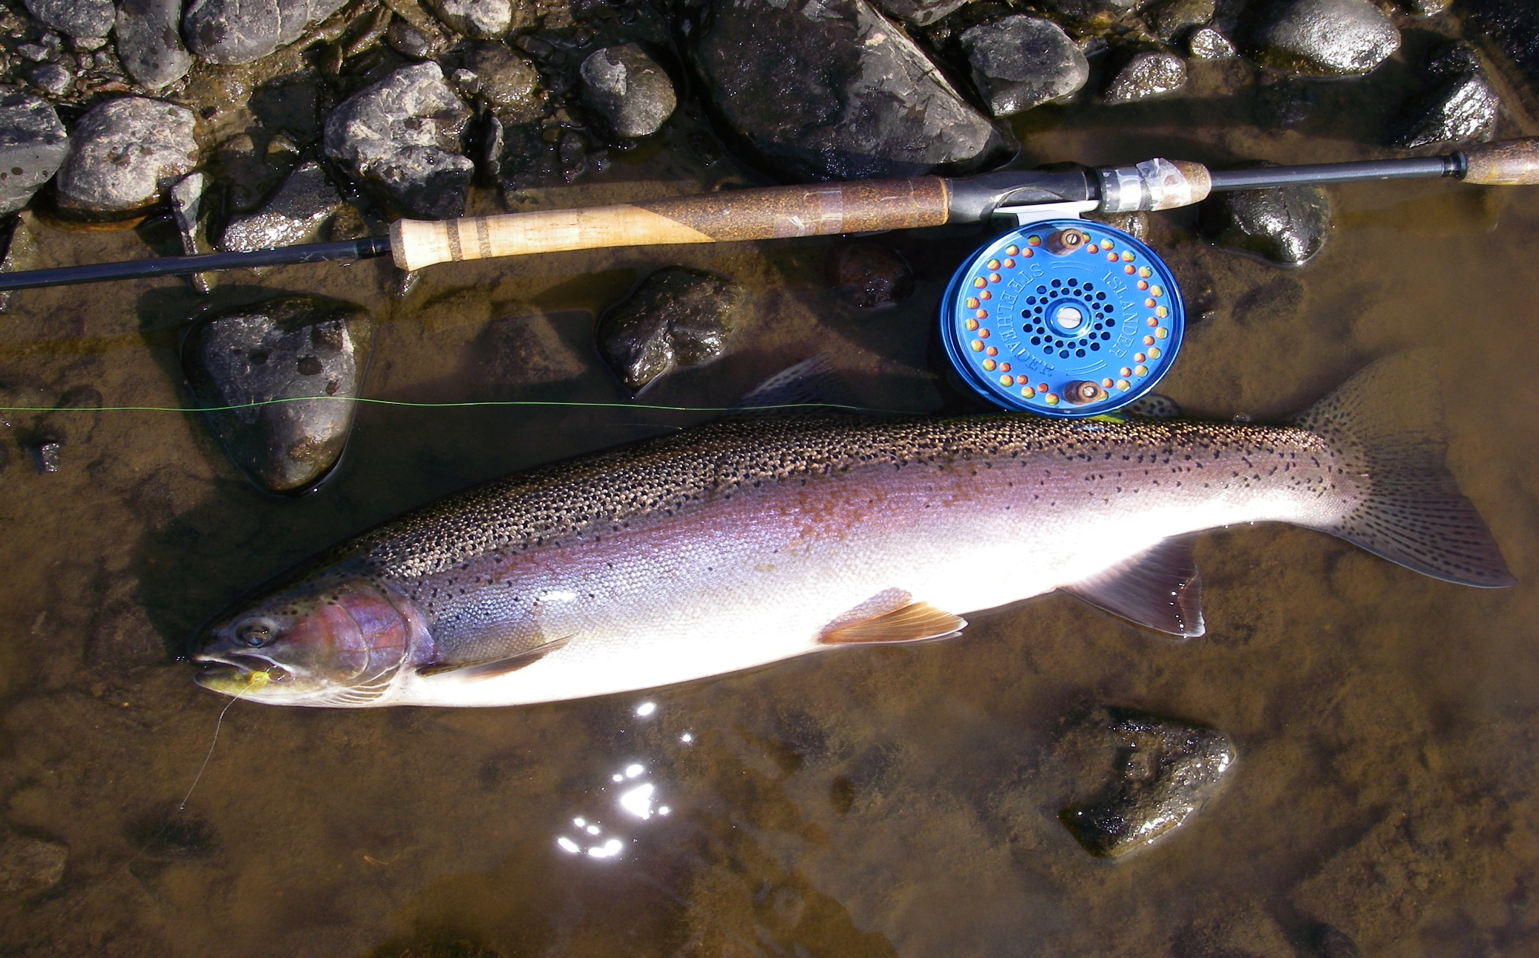
Wild Lake Superior Steelhead

Slide 3
Goals and Objectives
Partnership with Ontario Ministry of Natural Resources and
Forestry (OMNRF), Upper Great Lakes Management Unit
(UGLMU) and the North Shore Steelhead Association (NSSA)
Documenting the status of wild steelhead populations
in tributaries of western Lake Superior using adult
population estimates and life history characteristics
Applied science that can be used to develop steelhead
management plans and harvest regulations
Monitor present regulations and habitat manipulation…. before
and after (adaptive management)

Slide 4
Co-op Angler 2019
Introduction
Six steelhead assessment projects were conducted during the spring of 2019.
They are:
A) Neebing River Steelhead Population Assessment
B) McIntyre River Steelhead Population Assessment
C) McVicar Creek Steelhead Population Assessment
D) MacKenzie River Steelhead Population Assessment
E) Portage Creek Steelhead Population Assessment
F) Co-op Angler Study
All studies were conducted in partnership with the North Shore Steelhead Association (NSSA) and the Ontario Ministry of Natural Resources and Forestry, Upper Great Lakes Management Unit (OMNRF, UGLMU).

Slide 5
Steelhead Assessment 2019
Projects and Methods
A) Neebing River Steelhead Population Assessment
A partnership with the local land owner and OMNR Adult steelhead were captured (April and May) by angling then
biologically sampled (fork length, sex, and a scale sample)….in addition all steelhead were tagged and fin clipped.
B) McIntyre River Steelhead Population Assessment
Three experienced anglers biologically sampled, fin clipped adult steelhead they captured while angling during the
spring spawning migration (May and June).
C) McVicar Creek Steelhead Population Assessment
Three experienced anglers and a fisheries biologist biologically sampled, fin clipped adult steelhead they captured
while angling during the spring spawning migration (May and June).
D) Mackenzie River
One experienced angler/biologist biologically sampling and fin clipping adult steelhead during the spawning
migration (April to June).
D) Portage Creek Steelhead Population Assessment
Ministry of Natural Resources biologists, anglers from the NSSA angled, biologically sampled, fin clipped and tagged
adult steelhead during the spring spawning migration (May and June). All brook trout were also sampled and fin
clipped.
E) Co-op Angler
Anglers from the North Shore Steelhead Association received a sampling kit (measuring tape, glove, knife, envelopes
and instructions) and biologically sampled their adult steelhead catches (fork length, sex, and scale samples)
from north shore tributaries (Thunder Bay to Terrace Bay) from April to June. Scientific collectors permits were issued
by OMNRF.
The population estimates were based on a ‘Petersen Population Estimate’; Adult
steelhead are fin clipped in year one and recaptured in year two. The repeat spawners with
fin clips in year two complete the formula.

Slide 6
Steelhead Co-op Angler: Sampling Tributaries

Slide 7
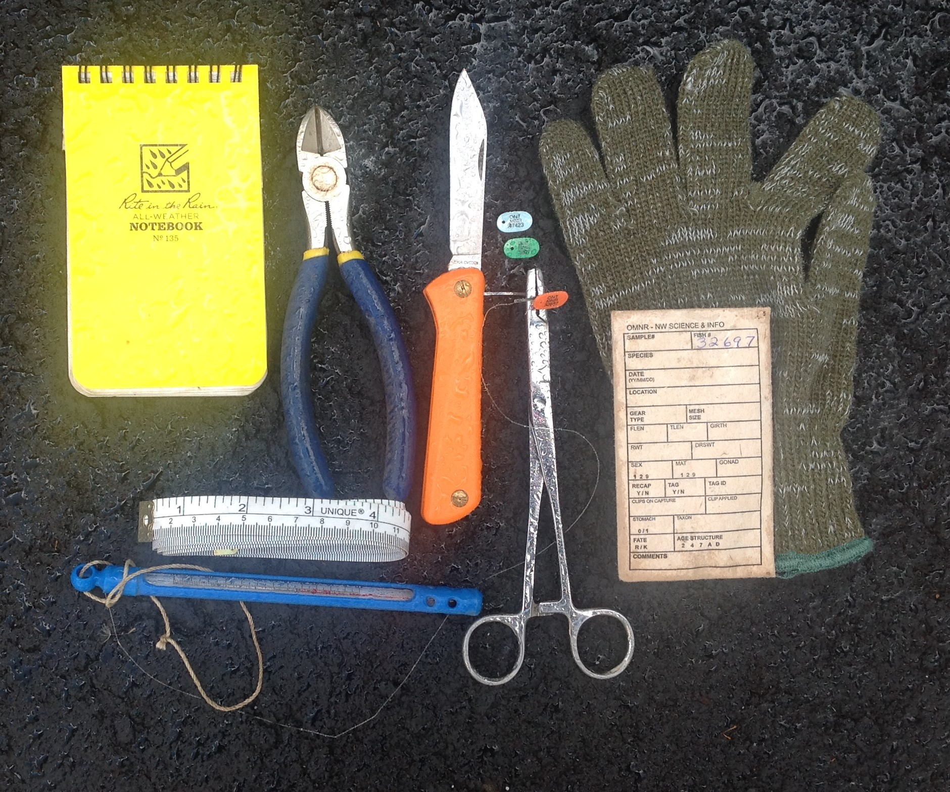
Sampling Kit

Slide 8
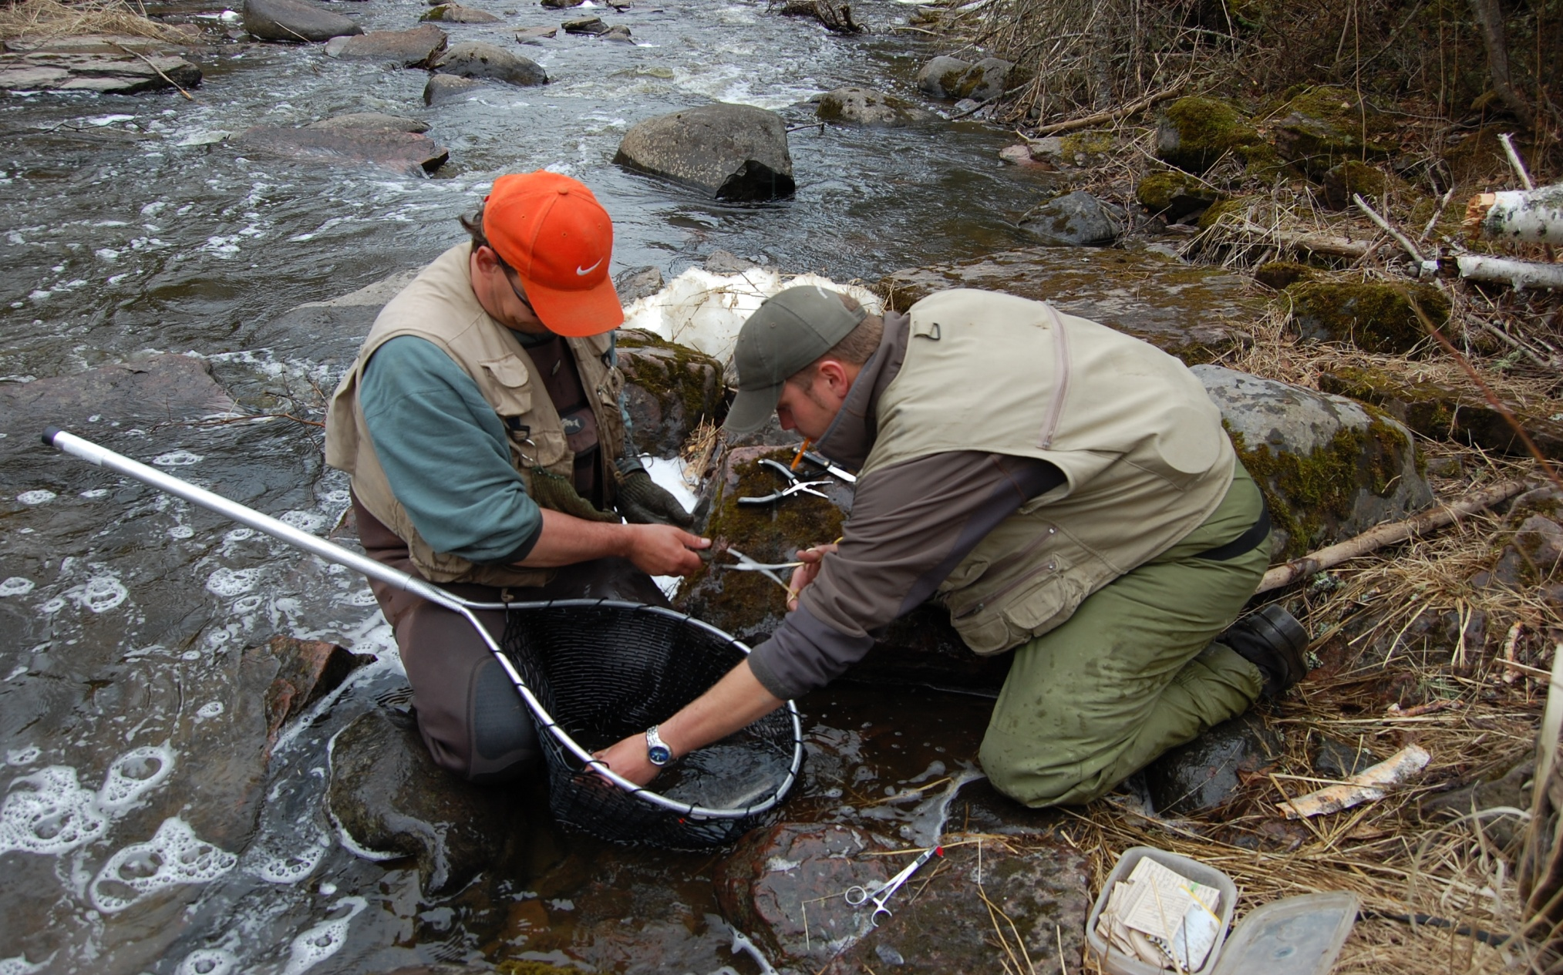
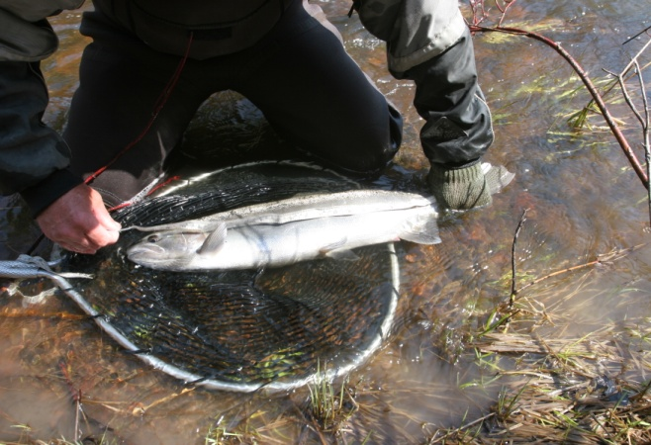
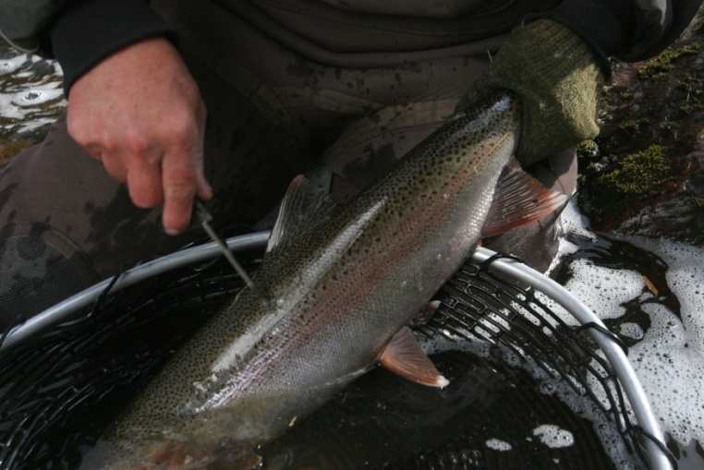
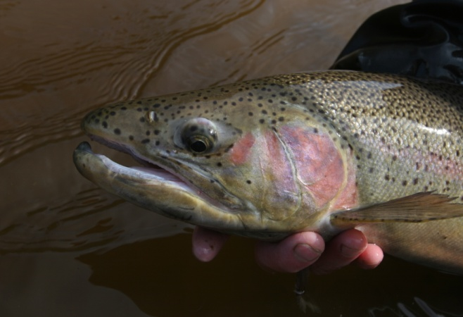
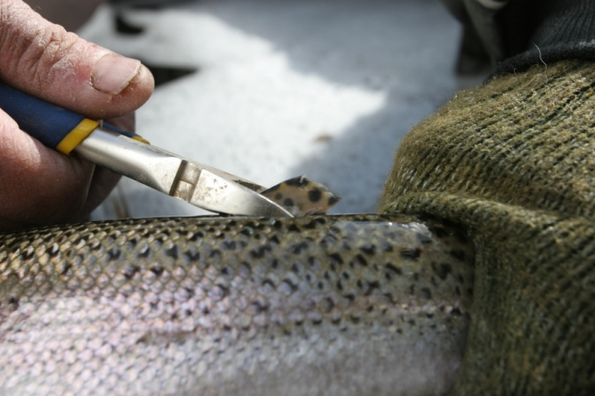
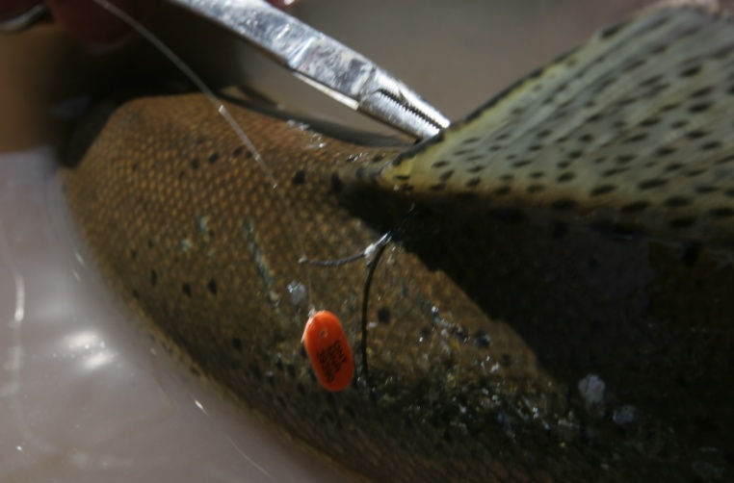
Sampling Procedure
Fork length (mm)
Sampling station
Scale sample
Male or Female
Yearly fin clip
Coloured, numbered tag

Slide 9
Co-op Angler, Sample Size / Stream 2019
 |  | Basin | Tributary | Sample Size
A |  | Thunder Bay | Neebing River | 257
 |  |  | McIntyre River | 265
 |  |  | McVicar Creek | 100
 |  |  | W. Goose/Blind Cr. | 17
 |  |  | Sibley Creek | 22
 |  |  | MacKenzie River | 60
B |  | Black Bay | Portage Creek | 42
 |  |  | Wolf River | 4
C |  | Nipigon Bay | Jackpine River | 46
 |  |  | Cypress River | 70
 |  |  | Steel River | 19
 |  | Sault Ste Marie |  | 27

Slide 10
Petersen Population Estimate
Number of Fish Clipped in Year #1 X Repeat Spawners in Year # 2 / by Clips from Year # 1 Captured in Year # 2
Example :
250 marked in Year #1
150 Repeat Spawners Year # 2
30 Marked fish from Year # 1 Captured in Year #2
250 X 150
------------ = 1259 +- 95 % Confidence (year #1)
30
Estimated Number of Adults
Neebing River…..3668 +- 3475 (north branch 2018)
McIntyre River…..4900 +- 4157 (2018)
McVicar Creek…..2484 (2016)
Portage Creek…..201 +- 168 (2018)
MacKenzie River..173 +- 67 (2018)
2018 population estimates for are based on recaptures from 2019

Slide 11
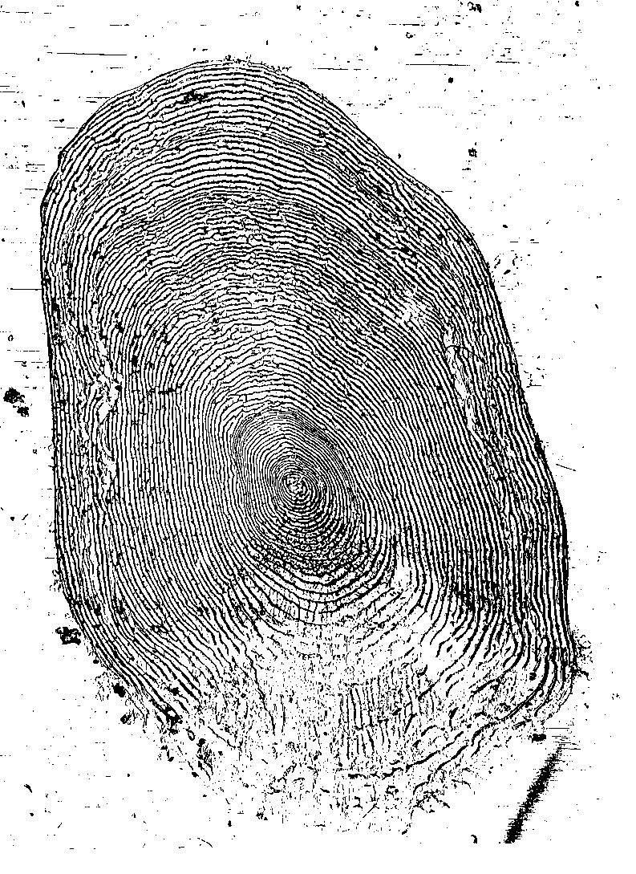
Data Obtained from Scale Samples
Number of stream years
Number of lake years
Total age
Age at maturity
Lake Years at Maturity
Number of spawning events
Size at age

Slide 12

Life History
Steelhead Scale: Age 5 years
(2 stream, 3 lake, 3rd spawn)
Third Lake Year, Third Spawn
Second Lake Year, Second Spawn
First Lake Year, First Spawn
Second Stream Year
First Stream Year
Notes:
EB: I moved this slide so that it is now an example for what you describe in slide 11

Slide 13
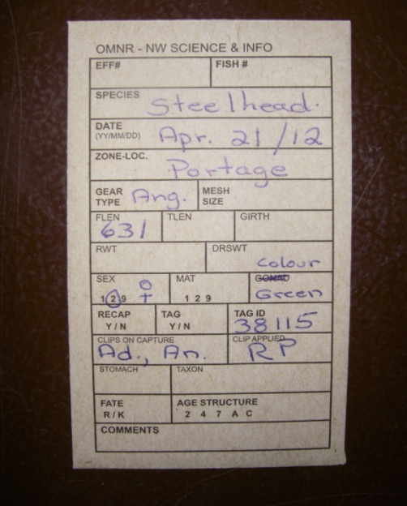
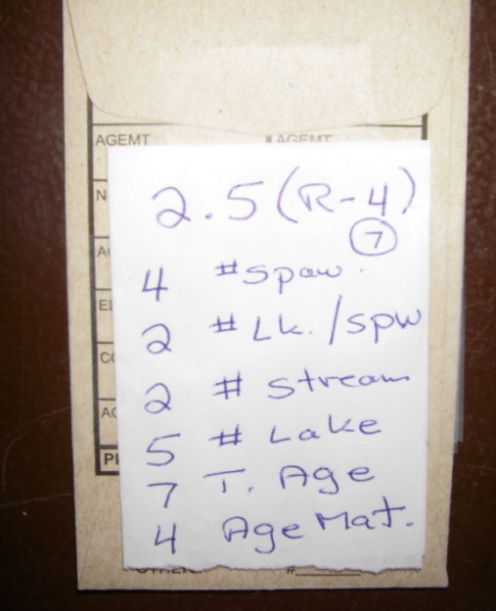
Data Management
A: Fish data is recorded on the
front of envelope, the scale
sample is placed inside.
B: Life history is coded on the back
of the envelope.
C: Life history data is transferred to
Excel spread sheet
A
B
Portage Creek Spring
 |  |  |  |  |  |  |  |  |  |  |  |  |  |  | Clips on Capture
Year | Date(d/m/y) | Colour | Tag | Flen | Lamp. | Sex | Spw. | L/spw. | Str. | Lk. | Age | Mat. | CLA | CLC3(FD) | CLC1(AD) | CLC7(RP) | CLC2(AN) | CLC5(LV)
2012 | 15/04/2012 | Yellow | 49000 | 432 |  | 1 | 1 | 2 | 1 | 2 | 3 | 3 | RP
2012 | 15/04/2012 | Yellow | 49001 | 581 |  | 2 | 2 | 2 | 2 | 3 | 5 | 4 | RP
2012 | 15/04/2012 | Yellow | 49002 | 384 |  | 1 | 1 | 2 | 1 | 2 | 3 | 3 | RP
2012 | 15/04/2012 | Yellow | 49003 | 479 | S | 1 | 2 | 1 | 1 | 2 | 3 | 2 | RP
2012 | 15/04/2012 | Yellow | 48004 | 614 |  | 1 | 2 | 3 | 1 | 4 | 5 | 4 | RP
2012 | 15/04/2012 | Yellow | 49005 | 366 |  | 1 | 1 | 1 | 1 | 1 | 2 | 2 | RP
2012 | 15/04/2012 | Yellow | 49006 | 551 |  | 1 | 2 | 2 | 1 | 3 | 4 | 3 | RP |  |  |  | An
2012 | 15/04/2012 | Yellow | 49008 | 594 | W | 2 | 6 | 2 | 1 | 7 | 8 | 3 | RP
2012 | 15/04/2012 | White | 44050 | 522 |  | 1 | 3 | 1 | 1 | 3 | 4 | 2 | RP |  | Ad |  |  | LV
2012 | 21/04/2012 | Yellow | 49009 | 492 |  | 2 | 1 | 2 | 1 | 2 | 3 | 3 | RP
2012 | 21/04/2012 | Yellow | 49010 | 521 |  | 2 | 1 | 2 | 1 | 2 | 3 | 3 | RP
2012 | 21/04/2012 | Green | 38115 | 631 |  | 2 | 4 | 2 | 2 | 5 | 7 | 4 | RP |  | Ad |  | An
C
Notes:
EB: If your short on time, remove this slide or be brief.

Slide 16
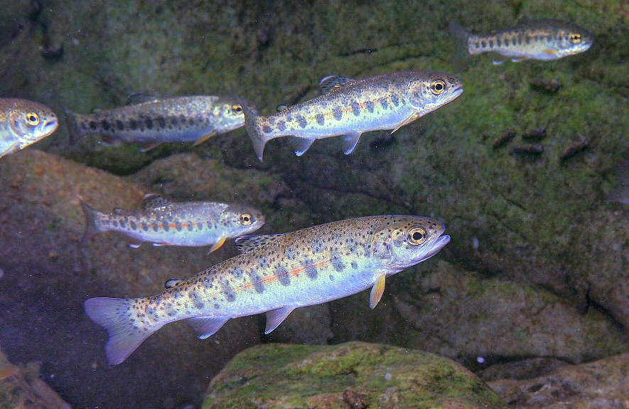
Smolting History 2019
Steelhead reside in their home spawning stream for one to three years before migrating (smolting) to Lake Superior. At age one year the young steelhead are approximately 8 cm. in length, 16 cm at age two years and 24 cm at age three years

Slide 17
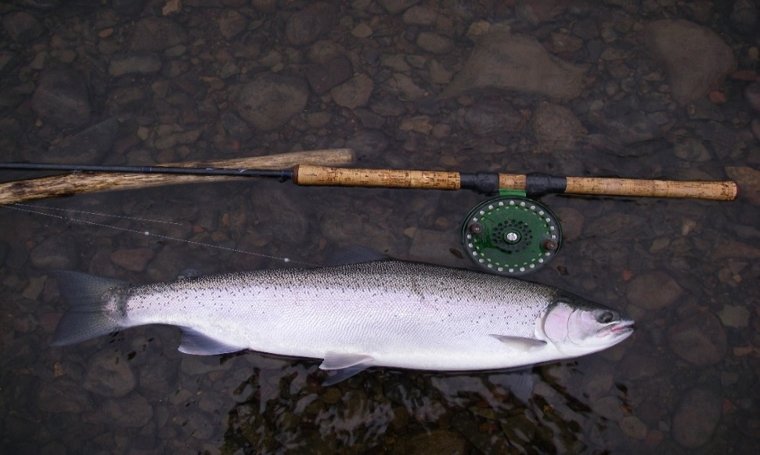
Age at First Spawn (Maturity)
Steelhead spawn for the first time (in the stream they were born) at age two years (males) to age six years. Age three to five is generally the age of the first spawning for both sexes. At maturity males have spent one to three years in Lake Superior and range in size from 30 to 60 cm. Females are generally a year older and have spent two to four years in Lake Superior and range from 48 to 65 cm.

Slide 18
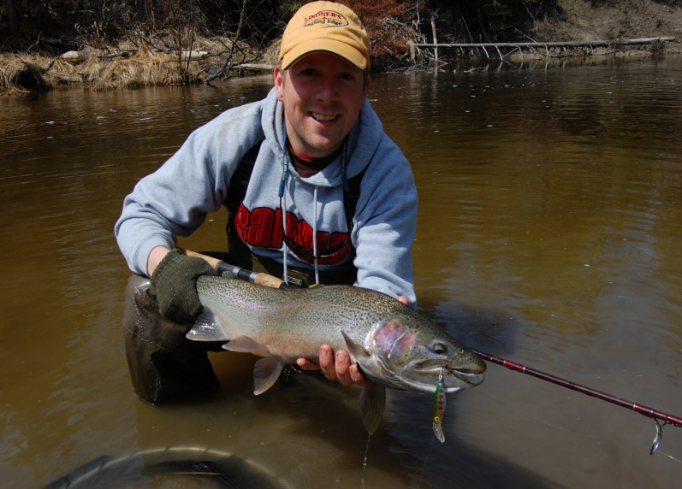
Repeat Spawners
Steelhead have the ability to repeat spawn in multiple years some in as many as nine consecutive spawning migrations. Natural mortality each spawning year is high (~30%)
A healthy adult Steelhead population:
55% repeat spawners = 45% total annual mortality (30% natural mortality, 15% fishing mortality or harvest)

Slide 19
Weight and Age of your Steelhead
Figure A
Length to Weight
A 60 cm. (24”) steelhead weighs 2.5 kg. or 5.5 Lbs.
A 75 cm. (30”) steelhead weighs 3.8 kg or 8.5 Lbs.
Figure B
Fork Length to Age
A 50 cm. (20”) steelhead is 3 years old
A 70 cm. (28”) steelhead is 7 years old
Note: Length at age will vary depending
on stream life and maturity
Fig. A
Fig. B

Slide 20
What is happening in Black Bay ??
The adult estimated steelhead population size in Portage Creek in 1992 was 500….increasing to over 2000 by 2003. In 2018 the population was estimated to be 200 individuals. (Fig. A).
In the early 1990 Portage Creek was open to fishing. In 1994 the lower stream was closed to fishing (private property). The increase in the adult steelhead population size (1994 to 2003) was probably the result of decreased harvest, followed by several strong production years (1998, 2000 and 2001).
The 2004 year class (age 3 in 2007) (Fig. B) was the last strong year and the strongest recruitment of juveniles to the adult population since the study began in 1991. From 2006 to 2019 the recruitment of age three steelhead has been low (Fig. B).The decline in the adult steelhead population (Fig. A) appears to be related to poor survival of juvenile steelhead from the smolt stage (migration from Portage Creek to Black Bay) to first time spawners. This decline in the steelhead population appears to correspond with changes in the Black Bay fish community after 2004.
Fig. A
Fig. B

Slide 21
Lake Superior Steelhead: Summary
Thunder Bay
A large adult population size, multiple age classes and high juvenile recruitment indicate healthy steelhead stocks in most of the urban Thunder Bay tributaries.
The MacKenzie River is the exception having a small estimated adult population in 2018 (173 +- 67) and low repeat spawning (46%) indicating a rather fragile steelhead stock.
Black Bay
Steelhead populations in Black Bay tributaries have declined from historic levels.
Portage Creek can be used to “index” other Black Bay steelhead population. Its population size has declined to 201 +- 168 (2018) from over 2000 (2007)… equivalent to a 90% decrease.
Poor survival of juvenile smolts to first time spawning (1995 to 2019) and low angler success in most major tributaries ie. Wolf, Black Sturgeon and Coldwater, has occurred over the past nine years.
Changes in the Black Bay fish community may have contributed to the apparent widespread decline in wild steelhead populations.
Nipigon Bay
Three tributaries of Nipigon Bay (Jackpine, Cypress and Steel Rivers) had high repeat spawning levels > 55 % (low annual mortality) and strong age three (2016) and age four (2015) recruiting age classes.
A diverse age structure, strong juvenile recruitment and a high percent of repeat spawning are indicators of a stable adult population.
A quantitative study on the Cypress River would address questions regarding population size

Slide 22
Acknowledgements
The author of this report would like to thank the following persons and groups for their contribution to the co-op angler program.
Neebing River Population Study:
Mike Zygmunt, Darren Kowalski
McIntyre River Population Study:
Randy Beamish, Keith Ailey, Terry Kosolowski,
McVicars Creek Population Study:
Kyle Stratton and George Stieh, Keith Ailey, Russ Desjardine
Portage Creek Population Study:
The North Shore Steelhead Association (NSSA )membership and Upper Great Lake Management
Unit (OMNRF) staff and Thunder Bay, OMNRF. Staff
Mackenzie River Population Study:
Kyle Stratton,
Co-op Angler Steelhead Data Collection:
Thanks to all the NSSA members that collected the data.
Aging and Data Management:
Jon Tost and Cyn Chappel, North Shore Environmental Services (NSES)
Corporate Sponsors:
Ray Collesso, Hook Line and Sinker, Guelph, Ontario
H. A. Kidd and Company Ltd. Toronto, Ont.
Funding:
NSSA and the Upper Great Lakes Management Unit (OMNRF)
Budget control and web site:
Frank Edgson and Scott McFadden

Slide 23
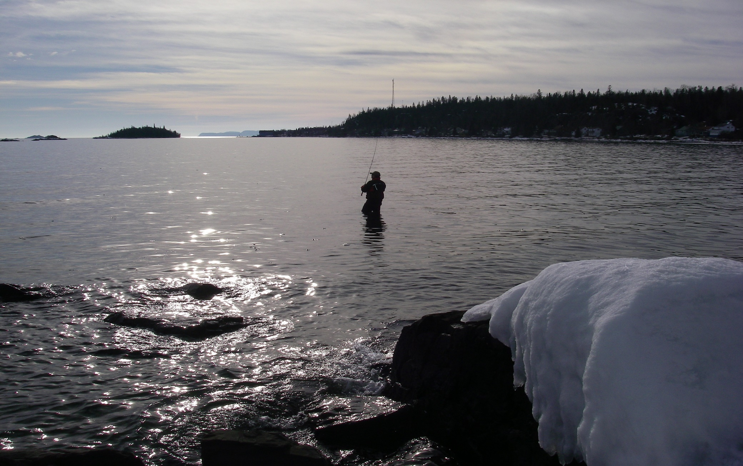
The Protection of Lake Superior’s Wild Steelhead Fishery is in Your Hands

