Slide 1
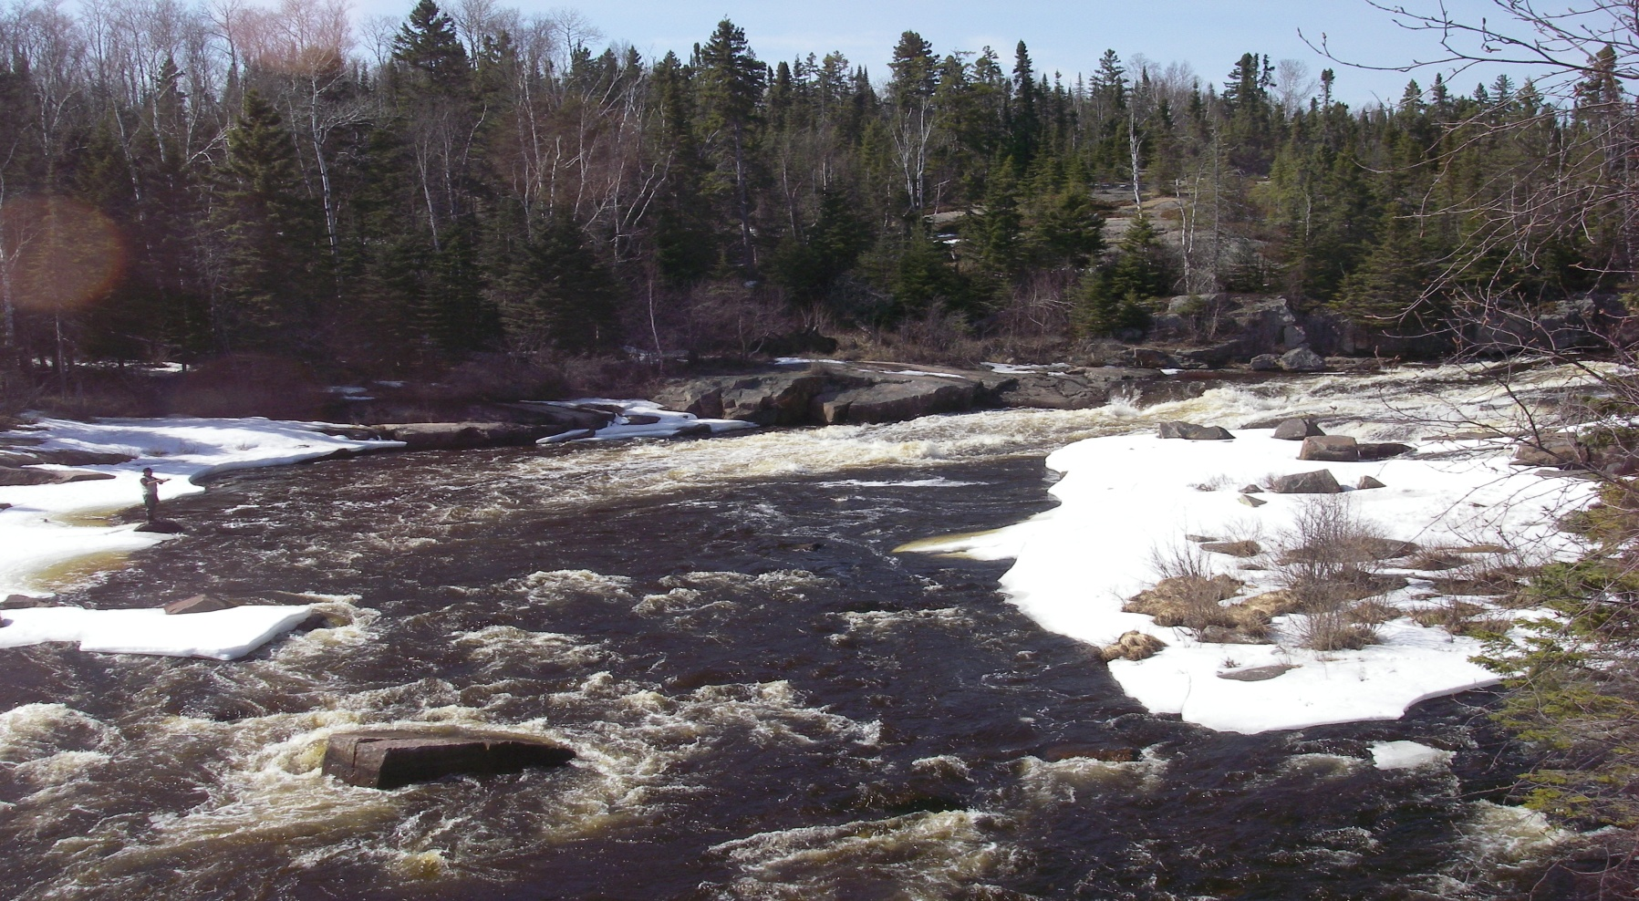


North Shore Steelhead Assessment A Partnership in Research
2016
By: Jon George

Slide 2
Goals and Objectives
Partnership with Ontario Ministry of Natural Resources and
Forestry (OMNRF), Upper Great Lakes Management Unit
(UGLMU) and the North Shore Steelhead Association (NSSA)
Documenting the status of wild steelhead populations
in tributaries of North West Lake Superior using adult
population estimates and life history characteristics
Applied science that can be used to develop steelhead
management plans and harvest regulations
Monitor present regulations and habitat manipulation…. before
and after (adaptive management)

Slide 3
Co-op Angler 2016
Introduction
Six steelhead assessment projects were conducted during the spring of 2016.
They are:
A) Neebing River Steelhead Population Assessment
B) McIntyre River Steelhead Population Assessment
C) McVicar Creek Steelhead Population Assessment
D) MacKenzie River Steelhead Population Assessment
E) Portage Creek Steelhead Population Assessment
F) Co-op Angler Study
All studies were conducted in partnership with the North Shore Steelhead Association (NSSA) and the Ontario Ministry of Natural Resources and Forestry, Upper Great Lakes Management Unit (OMNRF, UGLMU).

Slide 4
Steelhead Assessment 2016
Projects and Methods
A) Neebing River Steelhead Population Assessment
Two anglers from the NSSA worked with local land owners angling adult steelhead. Captured fish were
measured, sexed, and a scale sample taken….on the north branch adult steelhead were also tagged and fin clipped.
B) McIntyre River Steelhead Population Assessment
Three experienced anglers biologically sampled, fin clipped adult steelhead they captured while angling during the
spring spawning migration (May and June).
C) McVicar Creek Steelhead Population Assessment
Three experienced anglers biologically sampled, fin clipped adult steelhead they captured while angling during the
spring spawning migration (May and June).
D) Mackenzie River
One experienced angler biologically sampling and fin clipping adult steelhead during the spawning migration (April to
June).
D) Portage Creek Steelhead Population Assessment
Anglers from the NSSA angled, biologically sampled, fin clipped and tagged adult
steelhead during the spring spawning migration (May and June)
E) Co-op Angler
Anglers from the North Shore Steelhead Association received a sampling kit (measuring tape, glove, knife, envelopes
and instructions) and biologically sampled their adult steelhead catches (fork length, sex, and scale samples
from north shore tributaries (Thunder Bay to Terrace Bay) from April to June. Scientific permits were issued by MNR.
The population estimates were based on a ‘Petersen Population Estimate’; Adult
steelhead are fin clipped in year one and recaptured in year two. The repeat spawners with
fin clips in year two complete the formula.

Slide 5
Steelhead Co-op Angler: Sampling Tributaries

Slide 6
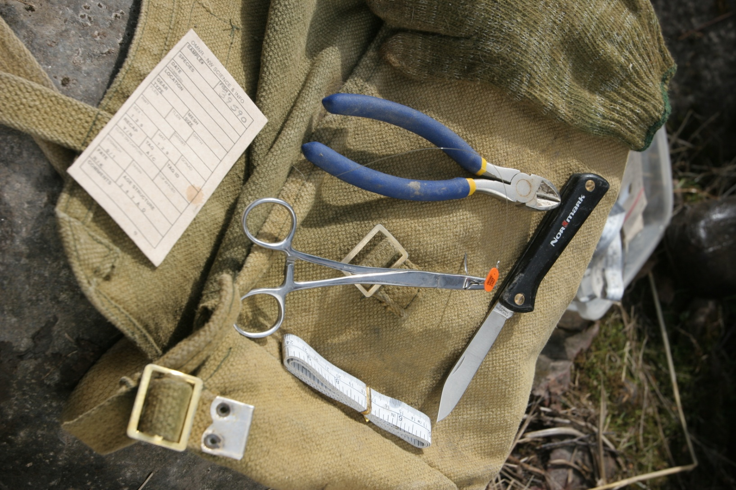
Sampling Kit

Slide 7
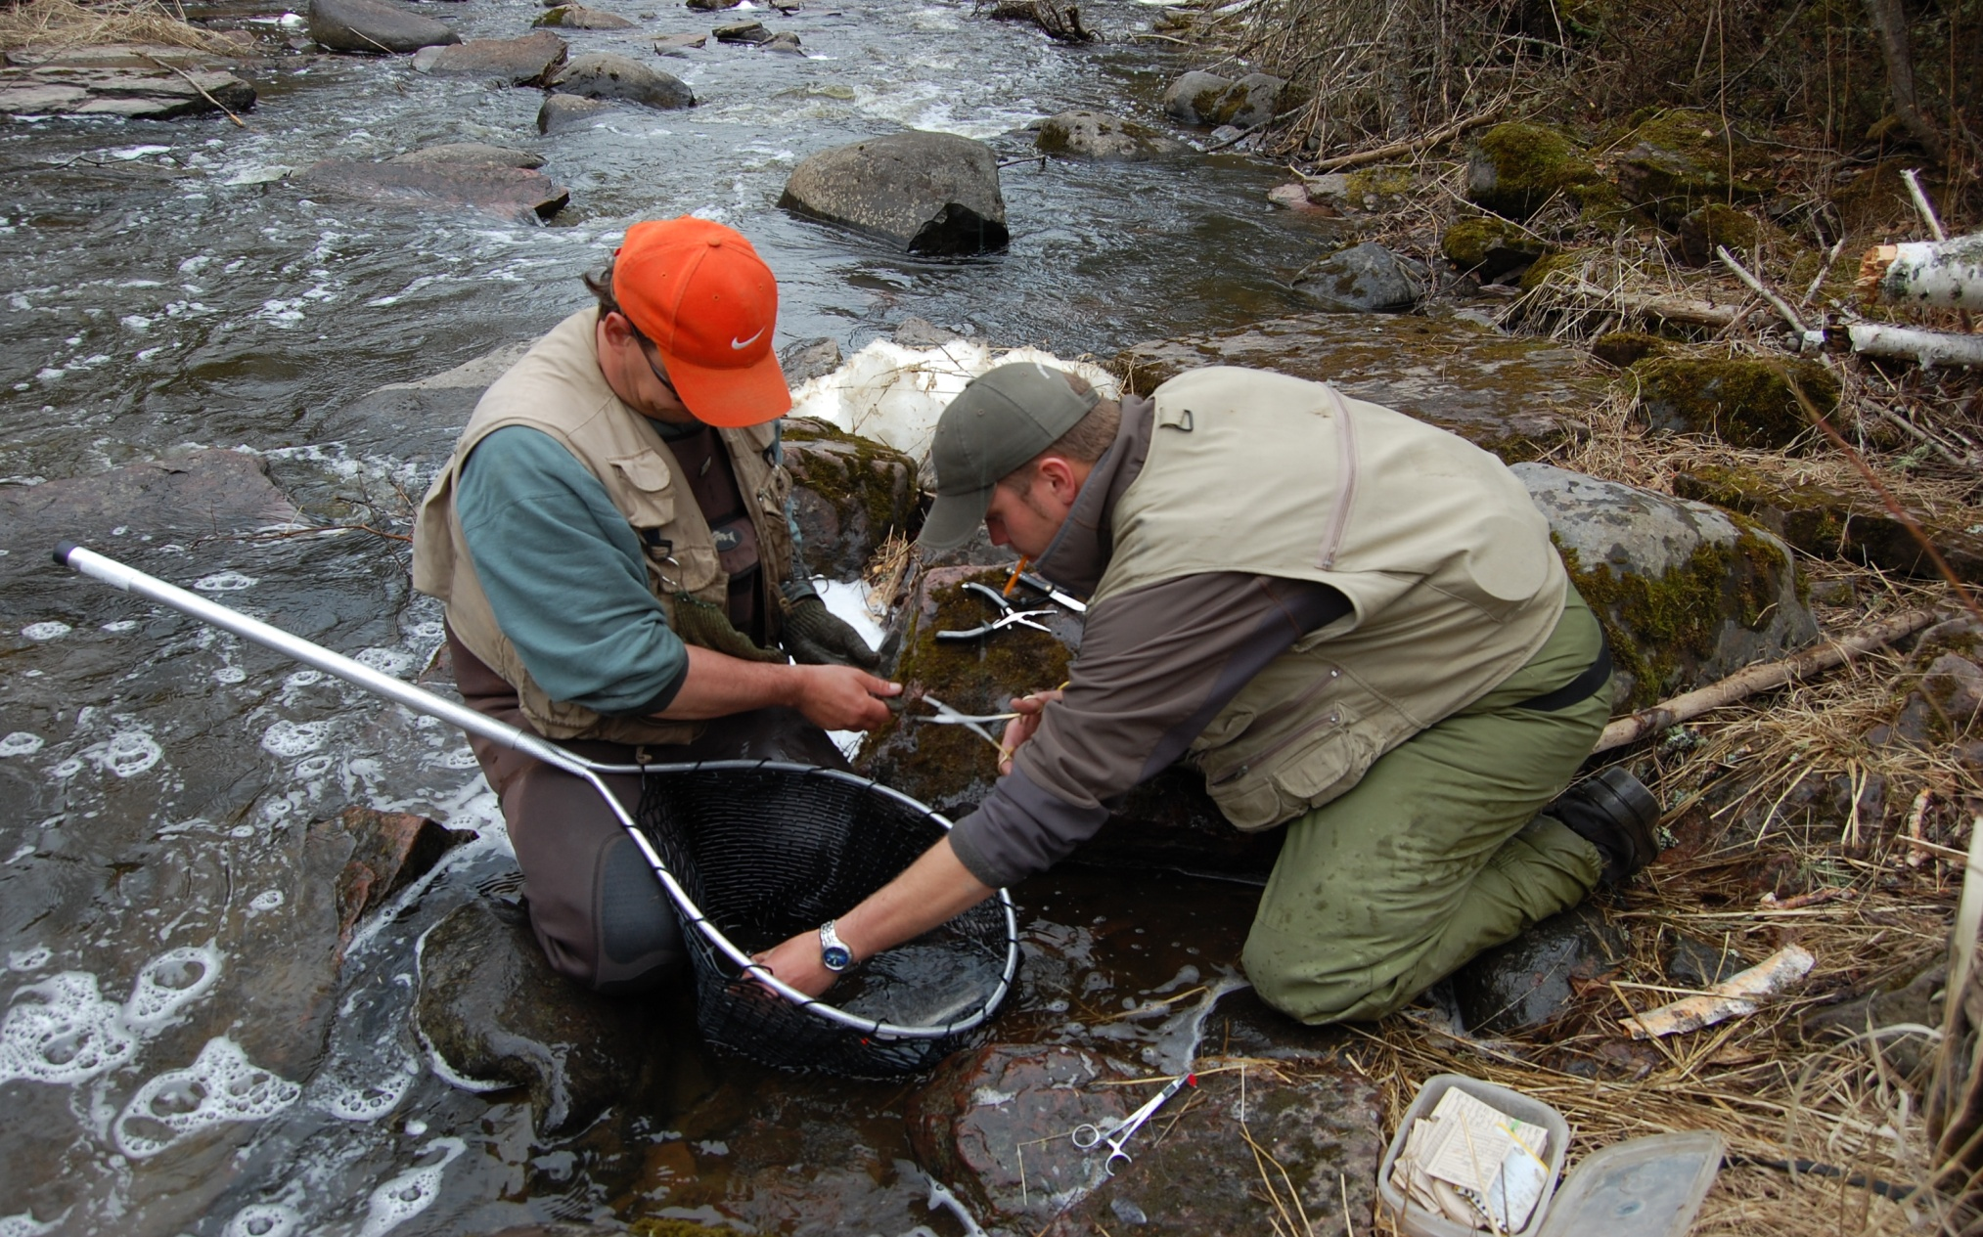
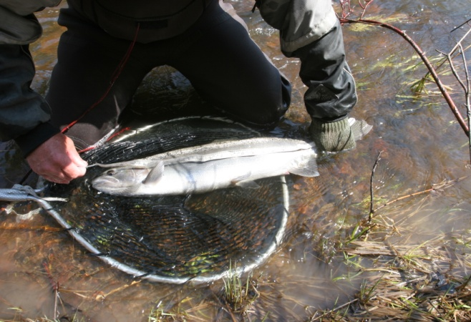
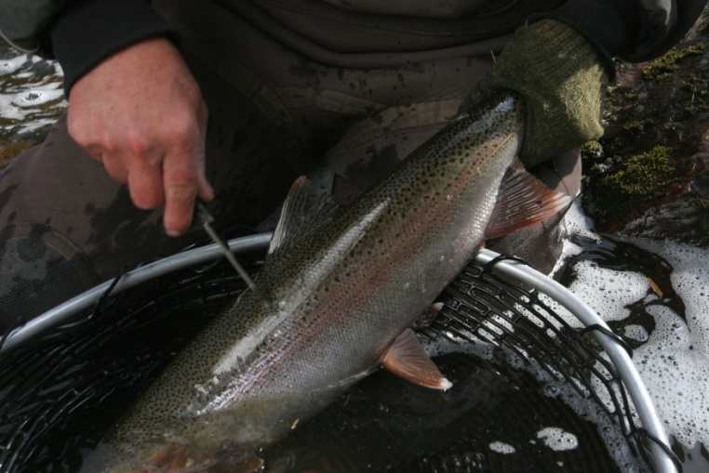
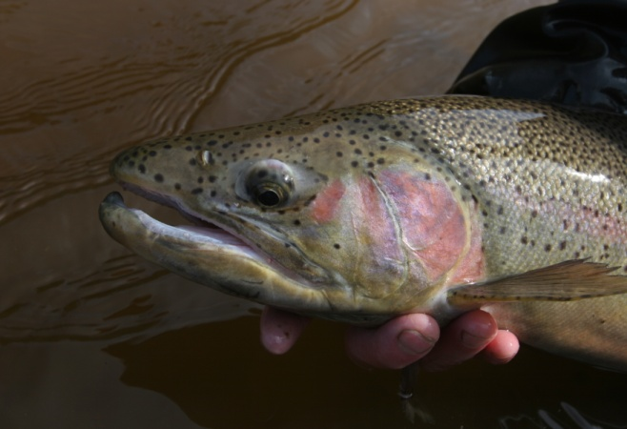
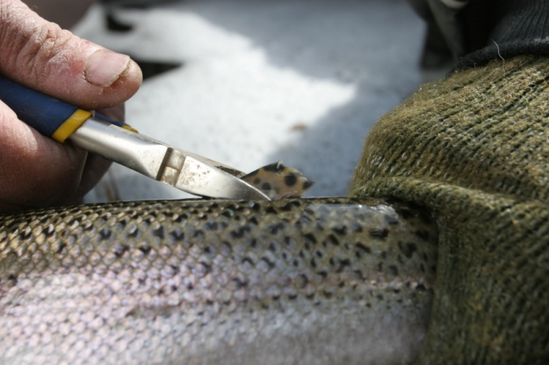
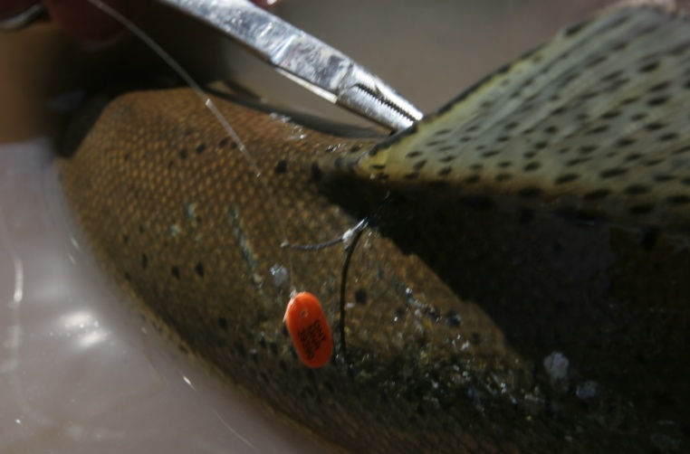
Sampling Procedure
Fork length (mm)
Sampling station
Scale sample
Male or Female
Yearly fin clip
Coloured, numbered tag

Slide 8
Co-op Angler, Sample Size / Stream 2015
 |  | Basin | Tributary | Sample Size
A |  | Thunder Bay | Whitefish River | 104
 |  |  | Neebing River | 238
 |  |  | McIntyre River | 326
 |  |  | McVicar Creek | 211
 |  |  | Blind Creek | 21
 |  |  | MacKenzie River | 84
B |  | Black Bay | Portage Creek | 60
 |  |  | Wolf River | 24
C |  | Nipigon Bay | Jackpine River | 118
 |  |  | Cypress River | 67
 |  |  | Prairie River | 40
 |  |  | Steel River | 21
 |  |  | Miscellaneous Nipigon Bay tribs. | 23
 |  | Sault Ste Marie | Lake Superior Park | 28
D |  |  | others | 23

Slide 9
Petersen Population Estimate
Number of Fish Clipped in Year #1 X Repeat Spawners in Year # 2 / by Clips from Year # 1 Captured in Year # 2
Example :
250 marked in Year #1
150 Repeat Spawners Year # 2
30 Marked fish from Year # 1 Captured in Year #2
250 X 150
------------ = 1259 +- 95 % Confidence (year #1)
30
Estimated Number of Adults
Neebing River…… 930 +- 516 (north branch 2015)
McIntyre River…...1457 +- 681 (2015)
McVicar Creek……1181 +- 488 (2015)
Portage Creek…… 275 +- 147 (2015)
2015 population estimates for are based on recaptures from 2016

Slide 10
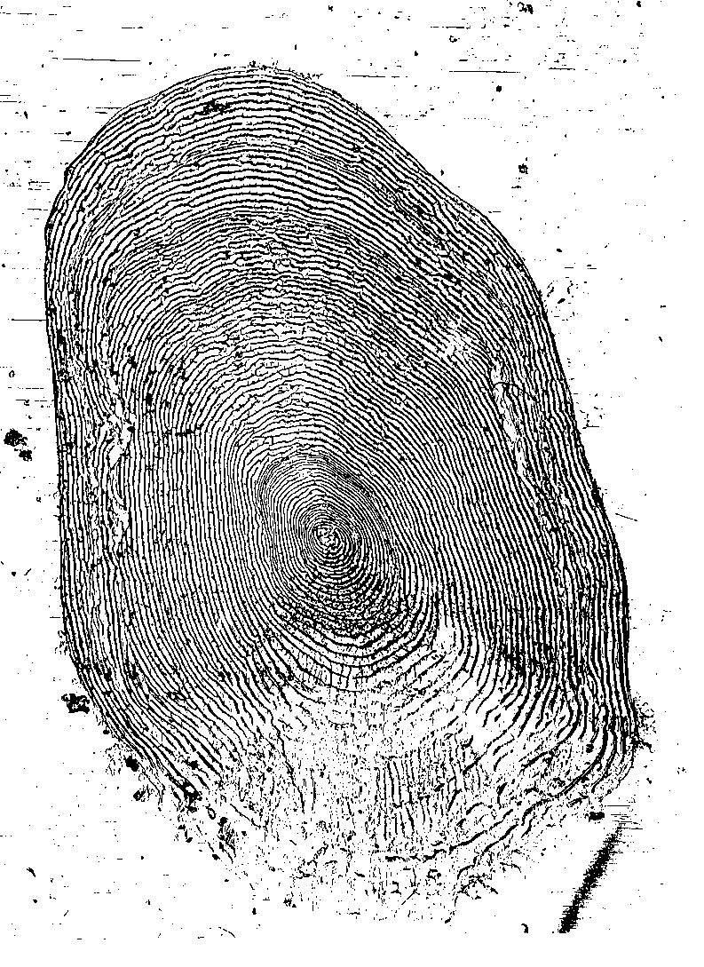
Data Obtained from Scale Samples
Number of stream years
Number of lake years
Total age
Age at maturity
Lake Years at Maturity
Number of spawning events
Size at age

Slide 11

Life History
Steelhead Scale: Age 5 years
(2 stream, 3 lake, 3rd spawn)
Third Lake Year, Third Spawn
Second Lake Year, Second Spawn
First Lake Year, First Spawn
Second Stream Year
First Stream Year
Notes:
EB: I moved this slide so that it is now an example for what you describe in slide 11

Slide 12
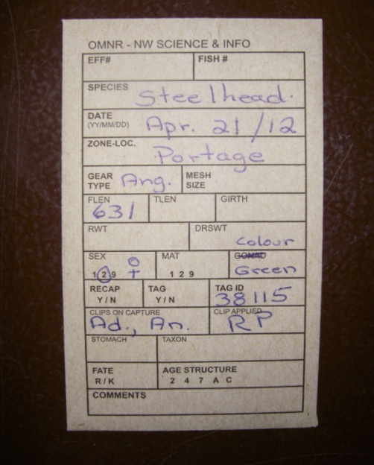
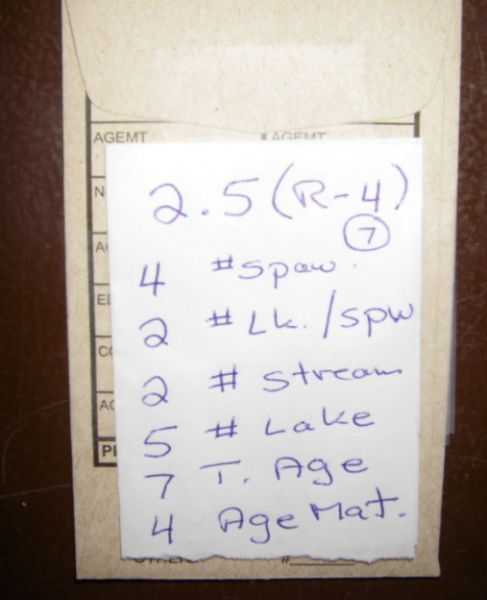
Data Management
A: Fish data is recorded on the
front of envelope, the scale
sample is placed inside.
B: Life history is coded on the back
of the envelope.
C: Life history data is transferred to
Excel spread sheet
A
B
Portage Creek Spring 2012
 |  |  |  |  |  |  |  |  |  |  |  |  |  |  | Clips on Capture
Year | Date(d/m/y) | Colour | Tag | Flen | Lamp. | Sex | Spw. | L/spw. | Str. | Lk. | Age | Mat. | CLA | CLC3(FD) | CLC1(AD) | CLC7(RP) | CLC2(AN) | CLC5(LV)
2012 | 15/04/2012 | Yellow | 49000 | 432 |  | 1 | 1 | 2 | 1 | 2 | 3 | 3 | RP
2012 | 15/04/2012 | Yellow | 49001 | 581 |  | 2 | 2 | 2 | 2 | 3 | 5 | 4 | RP
2012 | 15/04/2012 | Yellow | 49002 | 384 |  | 1 | 1 | 2 | 1 | 2 | 3 | 3 | RP
2012 | 15/04/2012 | Yellow | 49003 | 479 | S | 1 | 2 | 1 | 1 | 2 | 3 | 2 | RP
2012 | 15/04/2012 | Yellow | 48004 | 614 |  | 1 | 2 | 3 | 1 | 4 | 5 | 4 | RP
2012 | 15/04/2012 | Yellow | 49005 | 366 |  | 1 | 1 | 1 | 1 | 1 | 2 | 2 | RP
2012 | 15/04/2012 | Yellow | 49006 | 551 |  | 1 | 2 | 2 | 1 | 3 | 4 | 3 | RP |  |  |  | An
2012 | 15/04/2012 | Yellow | 49008 | 594 | W | 2 | 6 | 2 | 1 | 7 | 8 | 3 | RP
2012 | 15/04/2012 | White | 44050 | 522 |  | 1 | 3 | 1 | 1 | 3 | 4 | 2 | RP |  | Ad |  |  | LV
2012 | 21/04/2012 | Yellow | 49009 | 492 |  | 2 | 1 | 2 | 1 | 2 | 3 | 3 | RP
2012 | 21/04/2012 | Yellow | 49010 | 521 |  | 2 | 1 | 2 | 1 | 2 | 3 | 3 | RP
2012 | 21/04/2012 | Green | 38115 | 631 |  | 2 | 4 | 2 | 2 | 5 | 7 | 4 | RP |  | Ad |  | An
C
Notes:
EB: If your short on time, remove this slide or be brief.

Slide 13
Adult Steelhead Life History from Scale Sample
(Recorded on Excel Database)
Flen |  | Sex |  | Spw |  | Lk/Sp |  | St. |  | Lk. |  | Age |  | Mat.
450 |  | 2 |  | 1 |  | 2 |  | 1 |  | 2 |  | 3 |  | 3
380 |  | 1 |  | 1 |  | 1 |  | 2 |  | 1 |  | 3 |  | 3
470 |  | 1 |  | 2 |  | 1 |  | 2 |  | 2 |  | 4 |  | 3
510 |  | 1 |  | 2 |  | 1 |  | 2 |  | 2 |  | 4 |  | 3
580 |  | 2 |  | 1 |  | 2 |  | 2 |  | 2 |  | 4 |  | 4
600 |  | 2 |  | 2 |  | 3 |  | 2 |  | 4 |  | 6 |  | 5
540 |  | 1 |  | 2 |  | 1 |  | 2 |  | 2 |  | 4 |  | 3
340 |  | 1 |  | 1
680 |  | 2 |  | 5 |  | 2 |  | 2 |  | 6 |  | 8 |  | 4
470 |  | 2 |  | 1 |  | 2 |  | 2 |  | 2 |  | 4 |  | 4
510 |  | 1 |  | 2 |  | 1 |  | 2 |  | 2 |  | 4 |  | 3
610 |  | 2 |  | 6 |  | 2 |  | 1 |  | 7 |  | 8 |  | 3
690 |  | 9 |  | 4 |  | 3 |  | 2 |  | 6 |  | 8 |  | 5
640 |  | 2 |  | 3 |  | 2 |  | 2 |  | 4 |  | 6 |  | 4
490 |  | 1 |  | 2 |  | 2 |  | 1 |  | 3 |  | 4 |  | 3
580 |  | 2 |  | 1 |  | 3 |  | 1 |  | 3 |  | 4 |  | 4
Legend: Flen. (fork length mm.), Spw. (# of spawns), Lk/Sp (# lake years @ first spawn), St. (# stream years), Lk. (# lake years), Age (total age), Mat. (age at maturity)

Slide 17
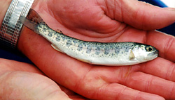
Smolting History 2016

Slide 18
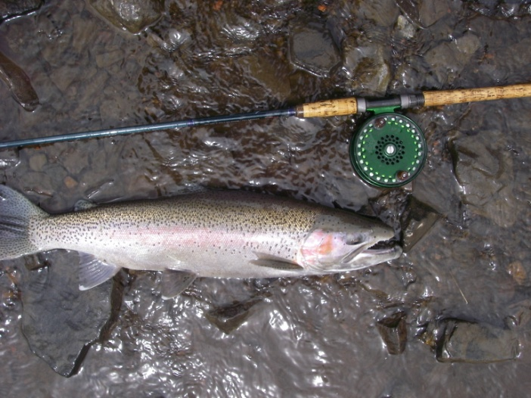
Steelhead Maturity

Slide 19
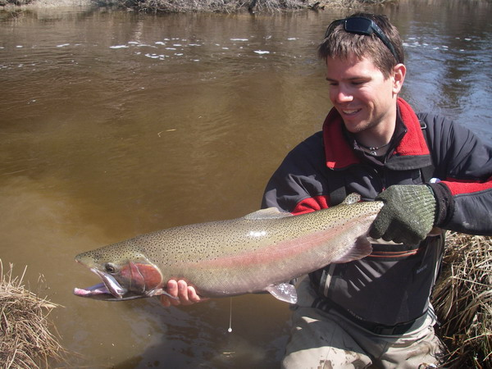
Repeat Spawners
A healthy adult Steelhead population:
55% repeat spawners = 45% total annual mortality (30% natural mortality, 15% fishing mortality or harvest)

Slide 20
Weight and Age of your Steelhead
Figure A
Length to Weight
A 60 cm. (24”) steelhead weighs 2.5 kg. or 5.5 Lbs.
A 75 cm. (30”) steelhead weighs 3.8 kg or 8.5 Lbs.
Figure B
Fork Length to Age
A 50 cm. (20”) steelhead is 3 years old
A 70 cm. (28”) steelhead is 7 years old
Note: Length at age will vary depending
on stream life and maturity
Fig. A
Fig. B

Slide 21
What is happening in Black Bay ??
The adult steelhead population size in Portage Creek was 500 in 1992….increasing to over 2000 in 2003 and back down to under 300 in 2014 Fig. A
In the early 1990 Portage Creek was open to fishing. In 1994 the lower stream was closed to fishing (private property). The increase in the adult steelhead population size (1994 to 2003) was the result of decreased harvest, followed by several strong production years (1998, 2000 and 2001).
The 2004 year class (age 3 in 2007) Fig. B was the last strong year and the strongest contribution of juveniles to the adult population Portage Creek has produced since the study began in 1991. From 2006 to 2016 the recruitment of age three steelhead has been low (Fig. B).The decline in the adult steelhead population (Fig. A) appears to be the result of poor survival of juvenile steelhead from the smolt stage (migration from Portage Creek to Black Bay) to first time spawners. This decline in the steelhead population corresponds with an increase in walleye and perch in Black Bay after 2004.
Fig. A
Fig. B

Slide 22
Lake Superior Steelhead: Summary
Thunder Bay
Thunder Bay tributary streams support significant wild populations of steelhead.
The McIntyre River has an estimated spawning run of 1400 to 2000 (2010 to 2015) while a smaller urban stream, McVicar Creek had an estimated adult population of 1200 to 1500 (2014 and 2015).
The 2010 to 2011 and 2013 year classes are well represented in the adult populations (strong year classes) in most tributaries.
The adult population size, age structure and high repeat spawning levels all indicate healthy steelhead stocks in the Thunder Bay basin.
Black Bay
Steelhead populations in Black Bay tributaries have declined from historic levels.
Portage Creek can be used to “index” what is occurring throughout Black Bay…..it’s adult steelhead population size has declined to 275 +- 147 (2015) from over 2000 (2007)… equivalent to an 86% decline.
Poor survival of juveniles to first time spawning (1995 to 2016) and low angler success in major tributaries has occurred over the past five years.
Changes in the Black Bay fish community (walleye and perch abundance) is the probable reason for the steelhead decline.
Nipigon Bay
Nipigon Bay steelhead streams appear healthy.
The 2009, 2010 and 2011 year classes in the Jackpine R. and Cypress R. are well represented.
The adult steelhead population in the Cypress River was estimated to be 1800 to 2300 (2013 and 2014).
A diverse age structure, a high percent of repeat spawning and good juvenile recruitment are all indicators of a high annual survival rate.

Slide 23
Acknowledgements
The author of this report would like to thank the following persons and groups for their contribution to the co-op angler program.
Neebing River Population Study:
Mike Zygmunt, Vilmars Forstmanis and Mike Stachejczuk
McIntyre River Population Study:
Randy Beamish, Keith Ailey and Terry Kosolowski
McVicars Creek Population Study:
Kyle Stratton, Norm and George Stieh
Portage Creek Population Study:
The North Shore Steelhead Association (NSSA )membership and Upper Great Lake Management
Unit (OMNRF) staff and Thunder Bay, OMNRF. Staff
Mackenzie River Population Study:
Kyle Stratton
Co-op Angler Steelhead Data Collection:
Thanks to all the NSSA members that collected the data.
Aging and Data Management:
Jon Tost and Cyn Chappel, North Shore Environmental Services (NSES)
Funding:
NSSA and the Upper Great Lakes Management Unit (OMNRF)
Corporate Sponsorship:
Normark Inc., Canada, H.A. Kidd and Company Ltd.
Budget control web site:
Frank Edgson and Scott McFadden

Slide 24
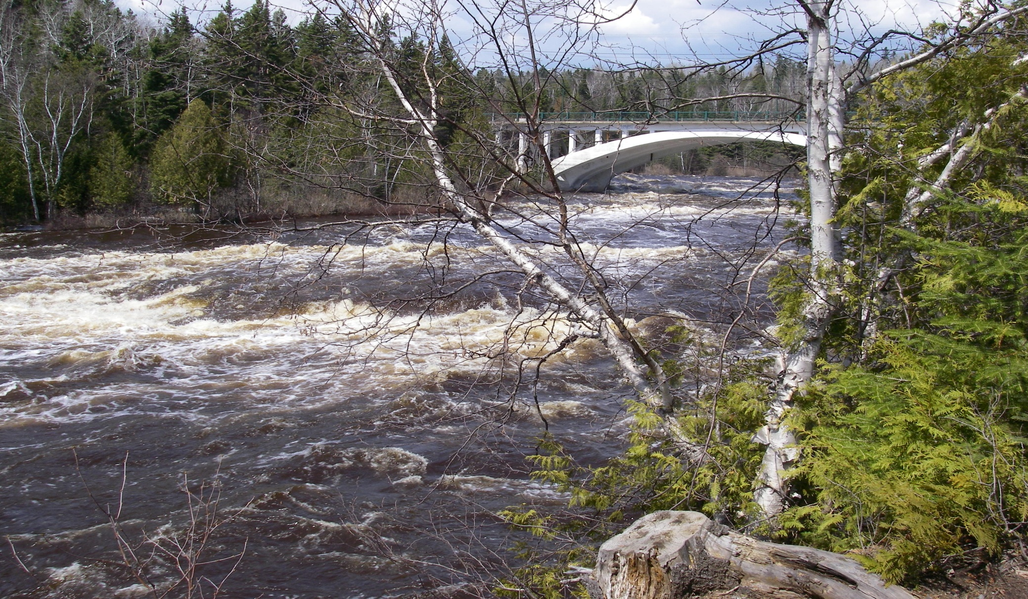
Future Activities
Maintain co-op angler program including population estimates
Continue Portage Creek research
Annual reports
Graduate work
Peer reviewed publications
Questions: jgeorge@tbaytel.net

Slide 25
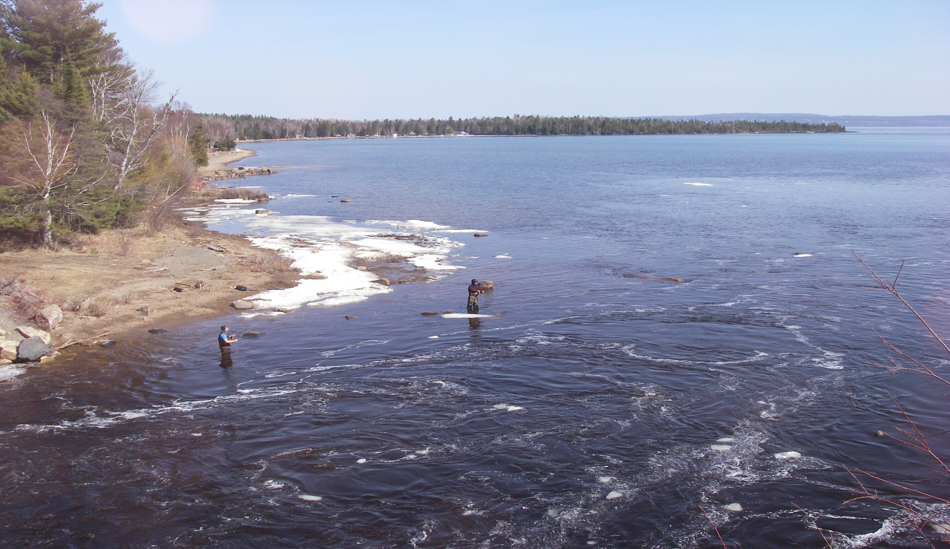
The Protection of Lake Superior’s Wild Steelhead Fishery is in Your Hands

